Slide 1
SPECIAL EDUCATION
RESIDENTIAL PLACEMENT
Registry for Facilities
USER’S GUIDE
FY 2025-26

Slide 2
PROGRAM OVERVIEW
DESE receives an annual appropriation to reimburse school districts for educational costs for disabled and nondisabled students admitted for short-term and long-term placement in approved residential alcohol/drug abuse and psychiatric facilities. The facility must be an approved Arkansas residential facility.
The Residential Placement Registry Web Application was created to help simplify the processing of reimbursements for the educational costs for disabled and nondisabled students in a residential placement facility. The residential facility initiates the process by registering students in their facility into the online Residential Placement Registry system each quarter with the most accurate information. The responsible school district must verify all information submitted by the facility and work in collaboration with the facility for any corrections. The school district must submit the Superintendent’s Certification to the State with the superintendent’s signature. After the State has verified all submitted claims and cleared all discrepancies, reimbursements will be dispersed to the school districts.
The procedures for out-of-state residential facilities will be the same as in previous years. The out-of-state facility will send detailed student information including instructional days to the school district. The school district will manually enter students online into the MYSPED Residential Placement Out-of-State application. Districts with out-of-state residential students will also need to submit the Superintendent’s Certification with the superintendent’s signature.

Slide 3
Reimbursement Requests In State/Out-of-State Facilities
Reimbursement Requests In State/Out-of-State Facilities
LEA# | School District
0203 | Hamburg
1602 | Westside Cons. (Jonesboro)
1611 | Nettleton
1803 | West Memphis
2002 | Fordyce
2203 | Monticello
2301 | Conway
2603 | Hot Springs
4605 | Texarkana
6001 | Little Rock
6003 | Pulaski County
6201 | Forrest City
6303 | Bryant
6601 | Fort Smith
7203 | Fayetteville
7207 | Springdale
7311 | Searcy
In-State Facilities
The school districts listed in the table have a facility within their jurisdiction. Residential reimbursement requests will be submitted online through the web-based Residential Placement Registry (RPR) by the facility. These school district’s will use the MYSPED Residential Placement (RPA) to verify the request submitted by the facility in their jurisdiction. During the verification process districts must contact the facilities if there are any billing discrepancies.
Out-Of-State Facilities
School districts will be receiving bills from the Out-Of-State facility. All out-of-state residential reimbursement requests must be submitted online through the MYSPED Residential Placement Out-of-State (RPA) by the district from which the student resides. Districts can request reimbursement for disabled students only.
*Note: The reimbursement rate will be $60 per day.

Slide 4
REQUESTING CURRENT QUARTER REIMBURSEMENTS
In-State facilities reimbursement requests must be submitted online through the web-based Residential Placement Registry (RPR) application by the facility for in-state. Out-of-state facilities must continue to submit detail student information to the responsible district for reimbursement request.
Quarter Due Dates
The calendar shown in the table below indicates Quarter (Service) Begin and End dates, quarterly RPR data entry dates, and quarterly deadlines for the submission of requests and the “Superintendent’s Certification”.
** RPA Cycle - Days that the Residential Placement Application will be available for data entry.
NO ENTRIES FOR REIMBURSEMENT REQUESTS AFTER 5:30 P.M. ON THE RPA CYCLE CLOSE DATE
 | Quarter (Service) Begin Date | Quarter (Service) End Date | Days in Quarter | ***RPA*** Cycle | DEADLINE for Facilities/Districts to Enter Student Data | DEADLINE for Superintendent Certification
Quarter 1 | August 11, 2025 | October 31, 2025 | 58 | August 11 - November 7 | November 7, 2025 | November 14, 2025
Quarter 2 | November 3, 2025 | December 19, 2025 | 30 | November 3 - January 5 | January 5, 2026 | January 16, 2026
Quarter 3 | January 5, 2026 | March 31, 2026 | 54 | January 5 - April 3 | April 3, 2026 | April 10, 2026
Quarter 4 | April 1, 2026 | May 21, 2026 | 36 | April 1 - May 29 | May 29, 2026 | June 05, 2026
 |  | TOTAL DAYS | 178

Slide 5
This calendar enables all residential facilities to invoice school districts for a maximum of 178 days of educational service. The same dates are available for all in-state and out-state residential facilities to provide educational services and invoice districts for these services. This calendar of eligible billing dates for residential educational services is to allow residential facilities to invoice districts for educational service that are provided on days schools are closed due to weather and/or road conditions.
Non-Billable Dates
Monday | August 11 | First Day |  | (First Billable Date)
Monday | Sept 1 | Labor Day | 1 | No School---Cannot bill for this day.
Monday | 22-Sep | Staff Development | 1 | No School---Cannot bill for this day.
Mon-Fri | Nov 24-28 | Thanksgiving | 5 | No School---Cannot bill for these days.
Mon-Wed | Dec 22-31 | Christmas | 8 | No School---Cannot bill for these days.
Thur-Fri | Jan 1-2 | New Years | 2 | No School---Cannot bill for these days.
Monday | Jan 19 | MLK Day | 1 | No School---Cannot bill for this day.
Friday | Feb-13 | Prof. Development | 1 | No School---Cannot bill for this day.
Monday | Feb 16 | President's Day | 1 | No School---Cannot bill for this day.
Mon-Fri | March 23-27 | Spring Break | 5 | No School---Cannot bill for these days.
Friday | April 17 | Prof. Development | 1 | No School---Cannot bill for this day.
Friday | May 21 | Last day |  | (Final Billable Date)

Slide 6
The only exceptions to the non-billable dates are dates approved by the Special Education Finance office as make-up days. Make-up days (due to weather and/or road conditions) may be requested by the facility representative by emailing the request for missed days to Mikki.Eubank@ade.arkansas.gov and copy Josh.Hart@ade.Arkansas.gov.
https://arksped.ade.arkansas.gov/Applications/RPA/RPA_SignIn.aspx?ReturnUrl=%2fApplications%2fRPA%2f
SUBMISSION OF PRIOR QUARTER REIMBURSEMENT REQUEST
Please note that once a quarter’s RPR cycle is closed, any late request will need to be keyed in the RPR Late Submission Application. Late submissions are only available for 1st, 2nd and 3rd quarters. Please note that late requests may be submitted online at any time after the 1st quarter but will not be considered for payment from the ADE until the 4th quarter of the fiscal year. Late submissions will be paid only during the 4th quarter of the fiscal year and only if sufficient funds remain after all current quarter requests have been processed/paid.

Slide 7
Opening an Account
An account registration form is available online. This form must be completed and submitted to ADE Special Education Grants and Data office in order to open an account. Once the account registration form has been received a username and password will be given for access to Residential Placement Registry (RPR). The username will be the LEA number of the district where the facility is located plus an assigned 3 digit code (Example: 6001001). See the account registration form for additional information.
GETTING STARTED
Go to the: ADE Website
Special Education
Funding & Finance
Residential Placement
RPR Application
Residential Placement Registry
https://arksped.ade.arkansas.gov/Applications/RPA/RPA_SignIn.aspx?ReturnUrl=%2fApplications%2fRPA%2f

Slide 8
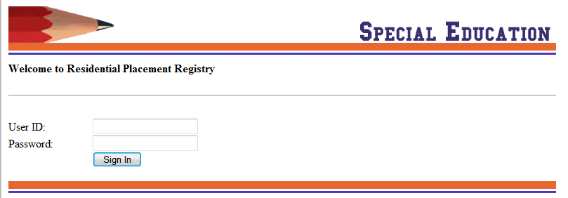
The login screen will appear. Enter the username and password assigned when the account was opened.
Once sign-in information has been accepted the menu below will appear with four options:
Residential Placement Registry (Regular) – Registry for entry of all regular instructional days on student for available quarter.
Residential Placement Registry (Late) – Registry for entry of all instructional days on student for a previous quarter.
Export to Excel – Export any given quarter to excel file.
Sign out - Exit Residential Reimbursement application.

Slide 9
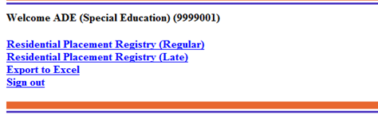
RESIDENTIAL PLACEMENT REGISTER (Regular)
Figure 2: Main Menu
Click on “Residential Placement Registry (Regular) in
Figure 2, the Residential Placement Registry (RPR)
Regular screen displays.

Slide 10
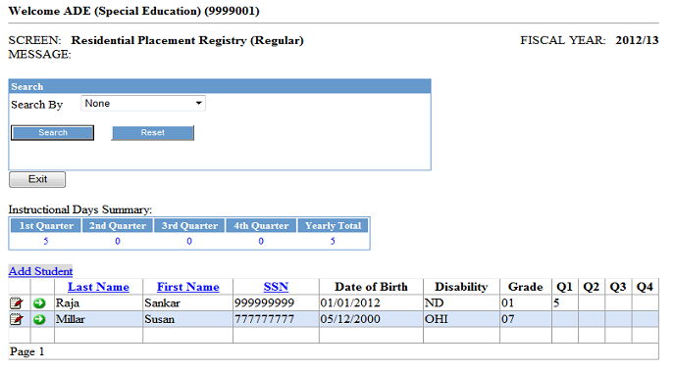
Figure 3: This initial screen list the student entries. The RPR (regular)
contains functions for adding new students, viewing all students in system, the total number days for the year and each quarter, a student search option, and an edit option to edit student detail information. The student information on this screen can be ordered by last name, first name and SSN.
2025-26
Figure 3:RPR (Regular) Screen

Slide 11
*****IMPORTANT*****
Adding Student Information – Please read carefully
After locating the Residential Placement Registry (Regular) screen, click on ‘Add Student’ option to begin entering information for students.
Figure 4 shows the screen for entering detailed information such as the student demographics, disability, last educational setting,
active or inactive status, and instruction days.
PLEASE DOUBLE CHECK SS #, NAME, DOB BEFORE ENTERING.
Only the information marked with the red asterisk * (upper section) is required for the system to “Save” a record for the student.
Do not add discharge status information for student until instructional dates have been finalized (see discharged student section).
A detail description of each field can be found on page 14 of this user guide. After the initial “Save” of the information per student, the only information that will need to be
maintained is the instructional days for each quarter.
PLEASE BE CAUTIOUS
When entering the student information.
Corrections can not be made once the “SAVE” button has been clicked. You will be required to contact the Special Education Finance Administrator at 501-682-4293 and ask for technical assistance concerning the RPR application.

Slide 12
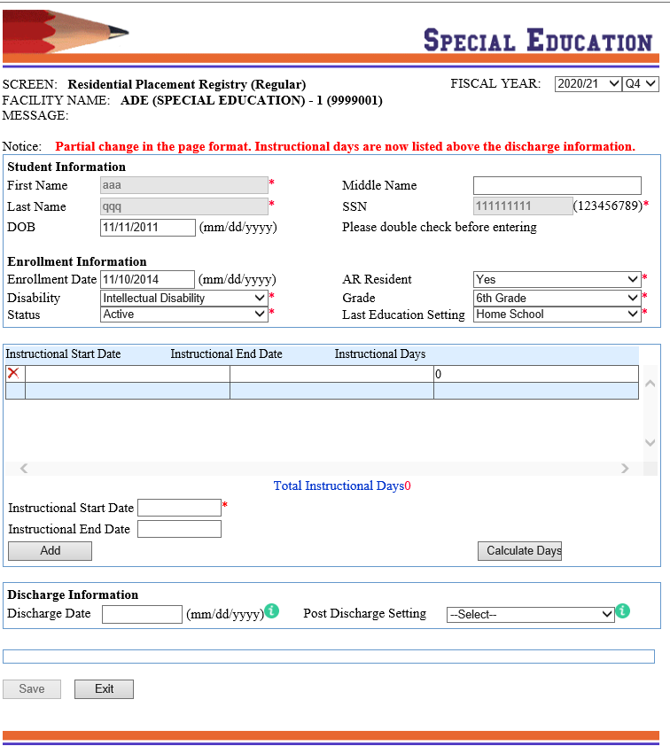
Figure: 4
Please note the new drop down box referring to AR Resident.

Slide 13
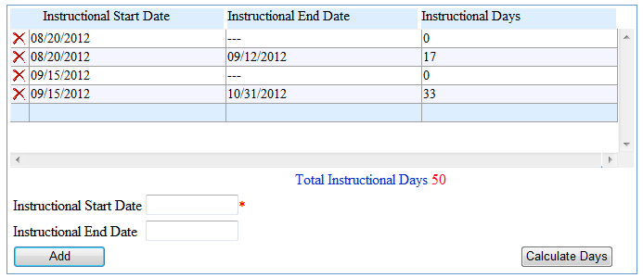
Adding Student Information (continues)
Figure 5: Instructional Days Section
The instructional days section has add and delete functions. Enter the “instructional start date” and “instructional end date” (last date of instruction or end of quarter date) for the instruction date interval. Then click the “Add” button, the date interval record will appear in the instruction date grid, therefore allowing the system to capture the information during the “Save” of the student record. If an existing date interval is not needed, click the delete button just before the date interval. The system will accept entry of just the “instructional start date”, in those cases where the end date is not yet known. The system will not include this interval in the calculation of total instructional days if there is not an end date. Another entry can be made when the end date is known (last date of instruction before discharge or last date for quarter). Add as many date intervals as needed in order to be accurate on the exact number of instructional days. For example, in Figure 5, the student enrolled in the facility on ‘08/20/2012’ but end date was not yet known. On ‘09/12/2012’ the student discharged. Another entry was made with the student’s start date ‘08/20/2012’ and the end date ‘09/12/2012’ of instruction.

Slide 14
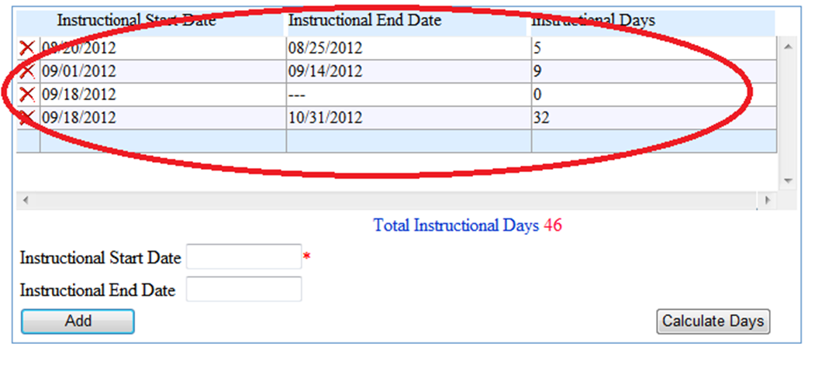
Adding Student Information (continues)
Exclude all absentee dates. If student misses a day of instruction for any reason, make another entry with the student’s start date, skipping
the missed date. The example in Figure 7 demonstrates this instance. On ‘09/17/2012’ the student was absent.
Another entry with start date ‘09/18/2012’ was made at that time. Later a final quarter entry was made using that same start date and the
end date for the quarter.
The “Save” button must be selected after the completion of adding a record and all edits, including the adding/deleting of instructional dates, for
changes to be saved in system. Make sure you see the “Successfully data has been saved” message for verification of save.
Figure 6

Slide 15
Figure 7

Slide 17
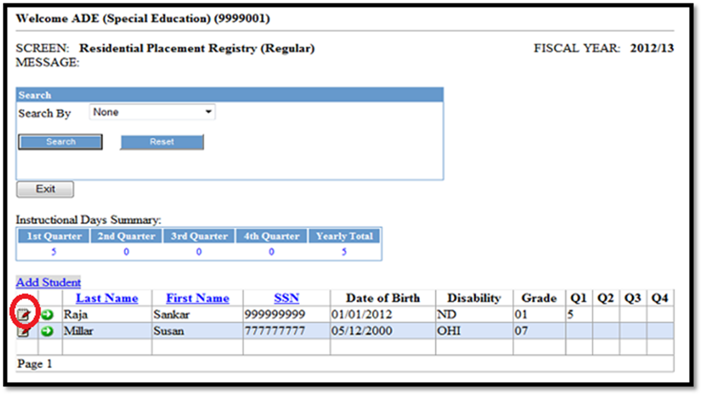
Editing Student Information
To edit a student’s record already entered and saved, click on (the EDIT icon) from the RPR (Regular) screen.
This provides access to the student’s detail information screen. After modifications to the record, always save the changes
before exiting the screen. If you select the “EDIT” icon and decide not to edit the information, just exit, to leave the
student detail information screen.
Discharged students cannot be edited.
Please refer to the discharged student's section for more information.
Figure 8

Slide 18
Figure 9

Slide 19
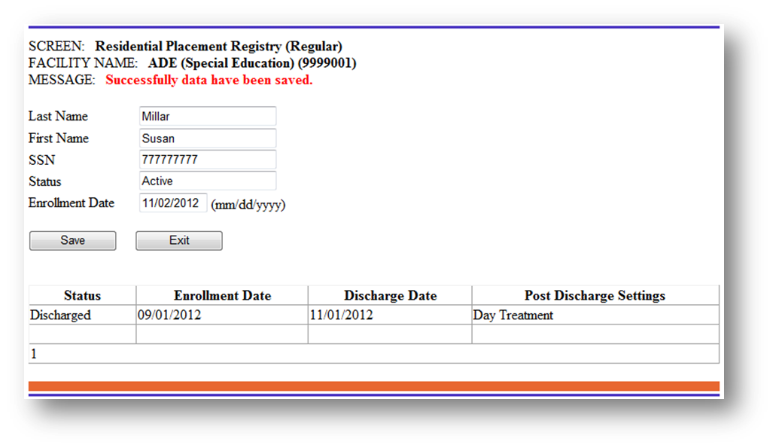
Figure 10
Searching for Students
The search section of the RPR (Regular) screen can be used to search for students by last name, first name, disability, grade level or active/inactive status. Just choose from the “search by” option list the search criteria base and add search information. Once a search is performed, the screen will only show students meeting the criteria entered. Choose the “reset” option to bring the screen back to normal. Information on screen can be ordered by last name, first name and SSN.

Slide 20
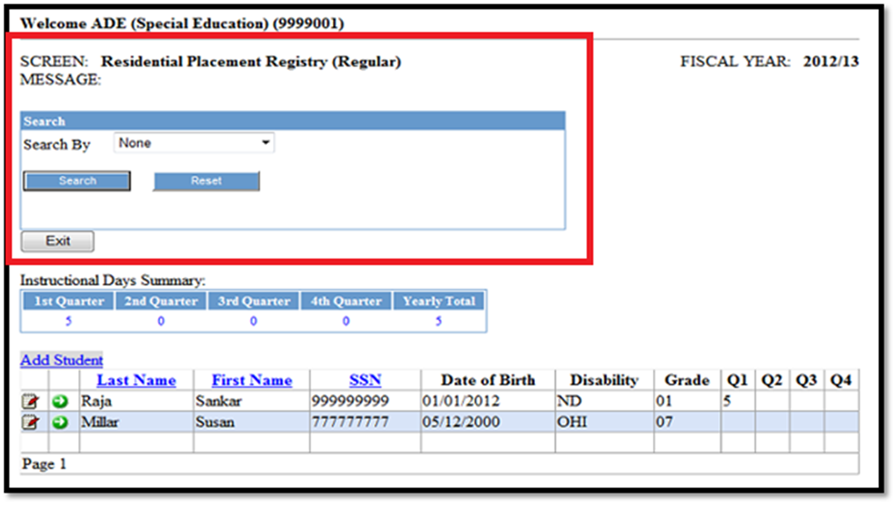
2025-26
Figure 11
Deleting Student Records
Currently a delete option is not available. Please contact the SPED Finance office directly if there is any reason a student needs to be deleted.

Slide 21
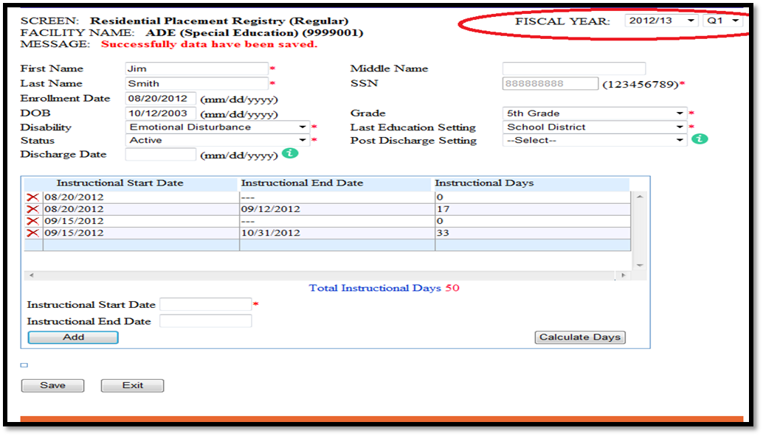
View previous Year/Quarter data
Previous quarter or year information can be viewed by clicking the drop down menu next to “Fiscal Year” in the right corner of the page on the student detail information screen. This is for viewing purposes only. Editing information in previous years or quarters will not be allowed.
2024-25
Figure 12
RPR LATE SUBMISSIONS
Late submissions are information from a previous quarter that was missed during the regular submission period.

Slide 22
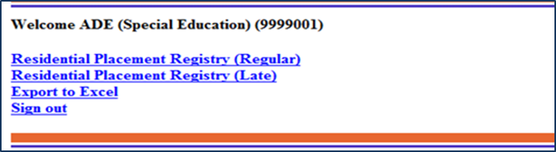
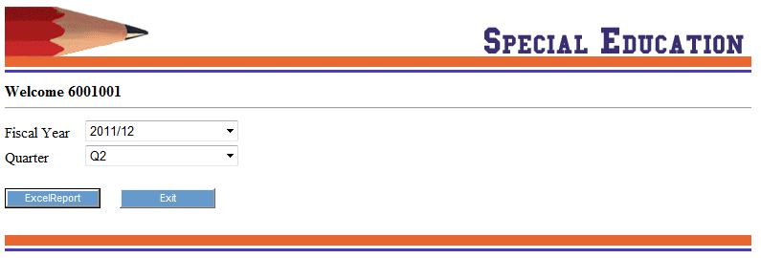
Figure 2: Main Menu
Export Data to Excel
2025-26

Slide 23
Invoicing Procedures
All information must be entered by the announced deadline (see page 4 for “Deadline for facilities to enter student data”) for the current quarter. A report can be generated for invoicing purposes. The facility is responsible for providing the school district with invoice summarizing the total cost using the current rate per day (Currently $60) for students with disabilities and without disabilities. The export to excel option on the main menu copies data from system. This data can be used to assist with the creation of an invoice.
If you have any problems please contact the ADE Special Education Unit, Finance office for assistance. Mikki Eubank 501-682-4293 or mikki.eubank@ade.arkansas.gov.

