Slide 1
SPECIAL EDUCATION
RESIDENTIAL PLACEMENT
USER’S GUIDE FOR DISTRICTS
FY 2025-26

Slide 2
PROGRAM OVERVIEW
DESE receives an annual appropriation to reimburse school districts for educational costs for disabled and nondisabled students admitted for short-term and long-term placement in approved residential alcohol/drug abuse and psychiatric facilities. The facility must be an approved Arkansas residential facility. Students receiving educational services in residential treatment facilities are not included in the district’s average daily membership. Any student (whether disabled or nondisabled) receiving educational services in a residential treatment facility for whom reimbursement is requested from the other system ADE should be coded in the Arkansas Public School Computer Network (APSCN) as a Resident “X”.
Payments received from the ADE designated as Fund/Source of Funds 2250 or 2255 are reimbursements for payments made by school districts to approved residential facilities. For ease of administration, all accounting transactions associated with these ADE payments should be coded as follows:

Slide 3
Coding for Residential Funding - Disabled Students
FY 2025-26 Funding-$60 Per Day
Revenue must be coded as Fund/Source 2255 Revenue Code 32340
Expenditures for Residential Funding — Disabled must be coded as:
Fund/Source 2255 Function 1270 Program Code 200 Object Code 65690
These expenditures should equal but not exceed residential funding for disabled students that is received from the state.

Slide 4
Coding for Residential Funding Non-Disabled Students
FY 2025-26 Funding—$60 Per Day
Revenue must be coded as Fund/Source 2250 Revenue Code 32330
Expenditures for Residential Funding—Non-disabled must be coded as:
Fund/Source 2250 Function 1197 Program Code 000 Object Code 65690
These expenditures should equal but not exceed residential funding for non-disabled students that is received from the state.

Slide 5
LEA# | School District
0203 | Hamburg
1602 | Westside Cons. (Jonesboro)
1611 | Nettleton
1803 | West Memphis
2002 | Fordyce
2203 | Monticello
2301 | Conway
2603 | Hot Springs
4605 | Texarkana
6001 | Little Rock
6003 | Pulaski County
6201 | Forrest City
6303 | Bryant
6601 | Fort Smith
7203 | Fayetteville
7207 | Springdale
7311 | Searcy
In-State Facilities
The school districts listed in the table have a facility within their city/town. Residential reimbursement requests will be submitted online through the web-based Residential Placement Application (RPA) by the facility. These school districts will use the web-based RPA to verify the request submitted by facility in their jurisdiction. During the verification process districts must contact the facilities if there are any billing discrepancies.
Out-Of-State Facilities
School districts will be receiving bills from the Out-Of-State facility. All out-of-state residential reimbursement requests must be submitted online through the MYSPED Residential Placement Out-of-State (RPA) by the district from which the student resides. Districts can request reimbursement for disabled students only.
*Note: The reimbursement rate will be $60 per day.

Slide 6
REQUESTING CURRENT QUARTER REIMBURSEMENTS
All reimbursement requests must be submitted online through the web-based Residential Placement Application (RPA) by the facility for in-state or by the resident district for out-of-state requests. The calendar shown in the table below indicates Quarter (Service) Begin and End dates, quarterly RPA data entry dates, and quarterly deadlines for the submission of requests and the “Superintendent’s Certification”.
REQUESTING CURRENT QUARTER REIMBURSEMENTS
All reimbursement requests must be submitted online through the web-based Residential Placement Application (RPA) by the facility for in-state or by the resident district for out-of-state requests. The calendar shown in the table below indicates Quarter (Service) Begin and End dates, quarterly RPA data entry dates, and quarterly deadlines for the submission of requests and the “Superintendent’s Certification”.
REQUESTING CURRENT QUARTER REIMBURSEMENTS
All reimbursement requests must be submitted online through the web-based Residential Placement Application (RPA) by the facility for in-state or by the resident district for out-of-state requests. The calendar shown in the table below indicates Quarter (Service) Begin and End dates, quarterly RPA data entry dates, and quarterly deadlines for the submission of requests and the “Superintendent’s Certification”.
** RPA Cycle - Days that the Residential Placement Application will be available for data entry.
NO ENTRIES FOR REIMBURSEMENT REQUESTS AFTER 5:30 P.M. ON THE RPA CYCLE CLOSE DATE
 | Quarter (Service) Begin Date | Quarter (Service) End Date | Days in Quarter | ***RPA*** Cycle | DEADLINE for Facilities/Districts to Enter Student Data | DEADLINE for Superintendent Certification
Quarter 1 | August 11, 2025 | October 31, 2025 | 58 | August 11 - November 7 | November 7, 2025 | November 14, 2025
Quarter 2 | November 3, 2025 | December 19, 2025 | 30 | November 3 - January 5 | January 5, 2026 | January 16, 2026
Quarter 3 | January 5, 2026 | March 31, 2026 | 54 | January 5 - April 3 | April 3, 2026 | April 10, 2026
Quarter 4 | April 1, 2026 | May 21, 2026 | 36 | April 1 - May 29 | May 29, 2026 | June 05, 2026
 |  | TOTAL DAYS | 178

Slide 7
This calendar enables all residential facilities to invoice school districts for a maximum of 178 days of education service. The calendar has been set so the same dates will be available for all in-state and out-of-state residential facilities to provide education services and invoice districts for these services. Make-up days for missed days may be requested by the facility representative by emailing a request to Mikki.Eubank@ade.arkansas.gov and copy Josh.Hart@ade.arkansas.gov.
Non-Billable Dates
Monday | August 11 | First Day |  | (First Billable Date)
Monday | Sept 1 | Labor Day | 1 | No School---Cannot bill for this day.
Monday | 22-Sep | Staff Development | 1 | No School---Cannot bill for this day.
Mon-Fri | Nov 24-28 | Thanksgiving | 5 | No School---Cannot bill for these days.
Mon-Wed | Dec 22-31 | Christmas | 8 | No School---Cannot bill for these days.
Thur-Fri | Jan 1-2 | New Years | 2 | No School---Cannot bill for these days.
Monday | Jan 19 | MLK Day | 1 | No School---Cannot bill for this day.
Friday | Feb-13 | Prof. Development | 1 | No School---Cannot bill for this day.
Monday | Feb 16 | President's Day | 1 | No School---Cannot bill for this day.
Mon-Fri | March 23-27 | Spring Break | 5 | No School---Cannot bill for these days.
Friday | April 17 | Prof. Development | 1 | No School---Cannot bill for this day.
Friday | May 21 | Last day |  | (Final Billable Date)

Slide 8
The only exceptions to the non-billable dates are dates approved by the Special Education Finance office as make-up days. Make-up days (due to weather and/or road conditions) may be requested by the facility representative by emailing the request for missed days to Mikki.Eubank@ade.arkansas.gov and copy Josh.Hart@ade.arkansas.gov.
SUPERINTENDENT CERTIFICATION
Following the quarterly RPA Cycle dates shown in the REQUESTING CURRENT QUARTER REIMBURSEMENTS section on page 4, email to mikki.eubank@ade.arkansas.gov or fax the signed “Superintendent Certification” sheet to SPED Finance at 501-682-4313 by the indicated deadline. Make sure to print the “Superintendent Certification” before the application closes (the RPA Cycle end date) each quarter. NO ADE PAYMENT WILL BE MADE UNTIL THE SIGNED SUPERINTENDENT CERTIFICATION IS EMAILED OR FAXED TO SPED Finance.

Slide 9
SUBMISSION OF PRIOR QUARTER REIMBURSEMENT REQUEST
Please note that once a quarter’s RPA cycle is closed, you will have to enter Late reimbursement requests
in the RPA Late Submissions Application. Late submissions are only available for 1st, 2nd and 3rd quarters.
Please note that late requests may be submitted online at any time but will not be considered for payment from the ADE until the 4th quarter of the fiscal year.
Late submissions will be paid only during the 4th quarter of the fiscal year and only if sufficient funds
remain after all current quarter requests have been processed/paid.
GETTING STARTED
Once the district has logged into MYSPED Resource place the mouse cursor over “Finance”. A drop down menu will display. Place the mouse cursor over Residential Placement and another menu will appear with
Five options: Residential Reimbursement-view only
Facility Report
Superintendent Certification
Late Submission-view only and Late Submission
Superintendent Certification
(next page)

Slide 10
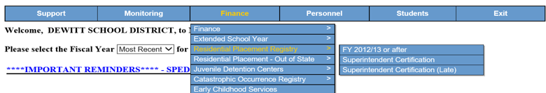
Verification of Residential Request
Click on “Residential Reimbursement”. The Residential Placement Application (RPA) will come up on the screen. Billing request information from the facility for residential reimbursement will be displayed and be available via this menu. The 17 districts with facilities in their jurisdiction will need to verify information and administer the usual procedures before submitting signed Superintendent Certification to the Special Educations Grants and Data office.

Slide 11
The Out-of-State Residential Reimbursement Application is an additional form to request reimbursement for students who are placed outside of the state of Arkansas in an approved out-of-state facility. To access this application, select Finance > Residential Placement – Out of State > and click on Residential Reimbursement.
Select the quarter, for entering information, from the drop-down box at the top of the screen and click “Get Data”. Key in the data for the quarter selected. The data entry section is set up the same way as the Residential Placement Application. When all information has been entered, click the “Facility Report” button to view totals by facility. Click on the Superintendent Certification button for the Superintendent to sign and follow the instructions on the document.

Slide 12
All fields are required except the “Middle” name field. Key in the student demographic information, including first/middle/last name, SSN, and the Birthdate. Insert a “D” for Disabled or a “N” for Nondisabled in the Disability Status field. Select the facility that the student was placed in from the drop down menu and key in the Begin Billing date and End Billing date.
A student can be entered more than once in the same quarter. However, the RPA will not accept dates that are the same for one student. For example, If Jane Doe enters Conway Behavioral Health at Conway on 08/31/2025, exits on 09/05/2025, and reenters on the same day she exited (09/05/2025), her second begin date will have to be keyed in as 09/06/2025. The same applies even if the student has been placed at a different facility.

Slide 13
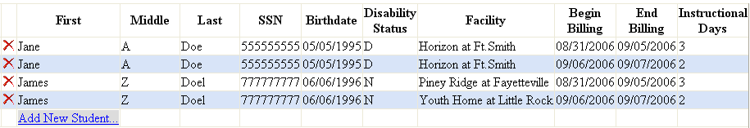
The last field “Instructional Days” is not editable. It is an automatic calculated total of the number of days (per student) that are billable according to the Beginning and Ending Billing Dates that were entered. The RPA uses the calendar outline on pages 6 and 7 when figuring instructional days (refer to for any date that is billable as an instructional day). Non-billable days will not show in the total under “Instructional Days”.

Slide 14
At the top of the screen, “Total Instructional Days” gives you the total of billable days that will be reimbursed the quarter, and the “Total Reimbursement” gives the total amount of reimbursement (# of days x $60) that your district will receive for the quarter that you are entering.
Total Instructional Days: 10 Total Reimbursement Amount: $60.00
SAVING AND EDITING INFORMATION
Once all information is entered for a student click on (the SAVE icon) to save the information. If you need to go back to a student record that has already been entered and saved, just click on (the EDIT icon) to change the information. Once changes are made, be sure to resave the student record by clicking on ( the SAVE icon).
If you select (the EDIT icon) and then decide that you do not want to edit the information, click on (the CANCEL icon), to leave the information the way it originally was before you clicked edit and/or made changes.

Slide 15
DELETING INFORMATION
Click on X (the DELETE icon) to delete an entire student record. Make sure the icon selected is directly beside the student’s name to ensure the correct student is deleted. Once you press X (the DELETE icon) the record is completely gone, and information will have to be reentered on the student to enter/place the student information back into the application.

Slide 16
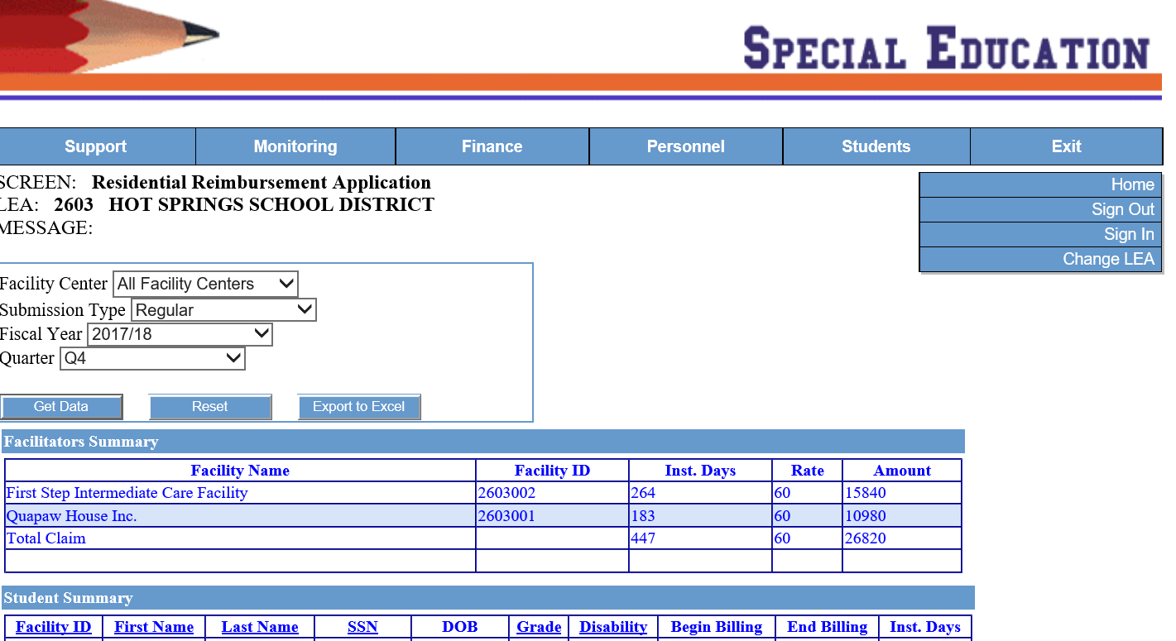
VIEW DATA FROM PREVIOUS YEAR(s)
Next to “Fiscal Year”, click on the drop-down arrow(s) to choose a previous year or previous
quarter within the year (see figure below). This is for viewing only. Editing information in previous
years or quarters will not be possible.
2025-26

Slide 18
Once all of your students have been entered, click on Late Submission-Supt. Certification. Select the desired quarter from the Quarter drop-down box at the top of the screen. Print a different Superintendent Certification for each Quarter in which you are requesting reimbursement. Districts should email to mikki.eubank@ade.arkansas.gov or fax the signed “Superintendent Certification” sheet to Sped Finance at 501-682-4313.

