Slide 1


Root Cause Analysis
DISPRO INSTITUTE 2017

Slide 2

The basics of root cause analysis
Root cause analysis is an approach for identifying the underlying causes of an incident so that the most effective solutions can be identified and Implemented. It’s typically used when something goes badly, but can also be used when something goes well. Within a district, problem solving, incident investigation, and root cause analysis are all fundamentally connected by three basic questions:
What’s the problem?
Why did it happen? (The most basic reason the problem occurs.)
What will be done to prevent it from happening again?

Slide 3
USING ROOT CAUSE ANALYSIS HELPS DISTRICTS TO….
Dissolve problems, not just the symptoms
Eliminate patching & wasted effort
Conserve scarce resources
Induce discussion & reflection
Provide a rationale for strategy selection

Slide 4

Symptom of the problem
“Disproportionate Representation of Culturally and Linguistically Diverse Students in Special Education.”
“The Weed” above the surface (obvious)
IGNORANCE
LACK OF / IGNORANCE OF DISRICT POLICIES
MISSING RECORDS
BAD/INDIFFERENT ATTITUDES
NO SCHOOL PROCEDURES
POOR PARENT PARTICIPATION
INSUFFICIENT
RESOURCES
The underlying causes
LANGUAGE DIFFERENCES
“The Root” below the surface (not obvious)
NO INTERPRETERS
HIGHLY MOBILE STUDENTS

Slide 5
The root cause analysis method of problem solving
Root cause analysis is about digging beneath the surface of a problem. However, instead of looking for a singular “root cause,” we shift our problem-solving paradigm to reveal a system of causes. When using Root Cause Analysis, the word root refers to causes that are beneath the surface.
The root is the system of causes that reveals all of the different options for solutions. The result … multiple opportunities to reduce risks and prevent problems.

Slide 6
3 problem-solving stepS
- - - - - - - - - -
Define the issue by its impact to overall goals. People often disagree over how to define the problem. You can get alignment when the problem is defined by the impact to the goals.
Break the problem down into a visual map. Using a Cause Map provides a thorough explanation revealing all of the causes required to produce the problem.
Prevent or mitigate any negative impact to the goals by selecting the best solutions. Effective solutions should make a change to district-level, building-level, or classroom-level practices.

Slide 7
A PROBLEM WELL DEFINED IS A PROBLEM HALF SOLVED
A clearly defined problem is an important step of the problem-solving process. Without a clear problem statement, people can drift off course, waste valuable time, and miss opportunities to solve the problem. The “problem” with defining problems is that everyone has a different perspective on what the “real” problem is. The Cause Mapping method uses a structured problem outline that reveals 3 key benefits to effective problem solving. A well-defined problem at onset will help you avoid the common pitfalls that can derail your investigations.
Three key benefits of a well-defined problem:
Problem alignment
Total impact – gaps & risks
Guidance on level of detail for analysis

Slide 8

The INDICATORS
Indicators help districts identify weakness that could be contributing to the problem of areas of Disproportionality in their districts
The Success Rubric is a tool for the district to think through where they are in the process of closing the gaps. The questions under indicators are for your reflection. If a district answers in the planning stage for a question, they may then dig deeper into the root cause of why they are not at the implementation stage….
It is important to consider each area carefully, remember, identifying he problem is ½ the solution!!!

Slide 9
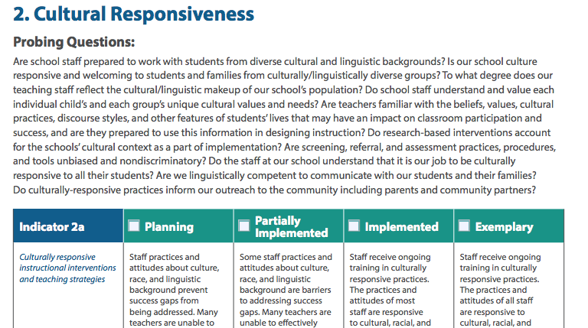
Are school staff prepared to work with students from diverse cultural and linguistic backgrounds?
Do research-based interventions account for the school’s cultural context as part of implementation?
Are we linguistically competent to communicate with our students and their families?

Slide 10
Better communication, better analysis
A Cause Map is a simple diagram showing how and why a particular issue occurred. It begins with a few Why questions (5 Whys), then expands into as much detail as necessary to (thoroughly) explain even the most challenging issues (30+ Whys).
The Cause Map creates a visual dialogue, making it easier to communicate what’s known and what needs a little more digging. People can see how all of the pieces fit together to produce a particular incident. The better a district gets at explaining its problems, the better it becomes at finding smart solutions.

Slide 11
Analyze
What happened?
Each step must
explain the step above it.
Why did it happen?
Why was that?
And why was that?
And why was that?
Down to the underlying root cause.
And why was that?

Slide 12
Caution! Generic buckets, PERCEIVED OBSTACLES & patches
- - - - - - - - -
Too often we use generic buckets like human error and procedure not followed to classify an entire incident. These are low-resolution investigations that result in weak solutions.
Clearly communicating detail is essential. Using root cause analysis flattens problem solving by deferring to the people in the district who know how well current processes actually work. A strong prevention culture makes it easier for people to share what they know. Administrators, teachers, and support staff are all an integral part of a districts overall problem-solving efforts.
Don’t waste times focusing on obstacles or restraining forces.
Much of what we do in schools is patching. Patches just add complexity and cost to the system. We have to think about dissolving the root rather than “fixing” the symptom with a patch. Once the root is dissolved, the symptom will go away of its own accord.

Slide 13
The 5 whys
Why?
Why?
Why?
The 5-Why approach is an excellent example of basic cause-and-effect analysis. Every investigation, regardless of size, begins with one Why question. The Why questions then continue, passing through five, until enough Why questions have been asked (and answered) to sufficiently explain the incident..

Slide 14
Analyze
What happened?
I was late!
Each step must
explain the step above it.
Why did it happen?
Traffic was bad.
What was that?
I left the house late.
I spilled coffee on my clothes & had to change.
And why was that?
And why was that?
I hit snooze too many times and slept late.
Down to the underlying root cause.
And why was that?
I stayed up too late.

Slide 15
When considering the Cause or causes…
Schools systems are social systems. They are far more complex than either mechanical or biological systems. For this reason, it is often impossible to isolate a single root cause, often several causes are identified that in combination bring about a symptom.

Slide 16

The longitudinal stream
Schools are longitudinal in nature given that it takes
13 yrs or more for a student to complete requirements for the typical high school diploma.
So, the most effective root cause analysis processes are not limited to the study of individual buildings, grades, or classrooms, but rather system-wide in scope.

Slide 17
IT’S YOUR TURN…
WHY?
8/10 teachers say office discipline referrals are ineffective. ..
My hair is a hot mess today. ..
Teachers do not show up for afternoon bus duty. ..
40% of my class failed the last assessment. ..
My cable went out last night…
I ran out of gas on my way to Dispro Institute…
I feel asleep during this presentation…
Less than 25% of parents attend conferences….
WHY?
WHY?
WHY?
WHY?

Slide 18
Cause & effect: Fishbone diagram

Slide 20
Levels of root cause
Root causes can be found at any one of the following levels:
Incident or procedural level
Example: The dog destroyed the garbage.
Programmatic or process level
Example: The bag was out of the trash bin and sitting by the back door.
Systemic level
Example: I put it there last night to take out this morning.
External Level
Example: Trash pick up is early on a work day.
It is important not to make an “incident” into a systemic issue or to treat a systemic issue as simply a bunch of incidents.

Slide 22
DATA
da·ta: ˈdadə,ˈdādə/, noun
  facts and statistics collected together for reference or analysis.
    COMPUTING
the quantities, characters, or symbols on which operations are performed by a computer,
being stored and transmitted in the form of electrical signals and recorded on magnetic, optical, or
mechanical recording media.
  PHILOSOPHY
things known or assumed as facts, making the basis of reasoning or calculation.
Synonyms: facts, figures, statistics, details, particulars, specifics.
When working through the Root Cause Analysis process it is important to base decisions on data.

Slide 23
Prevent or mitigate any negative impact to the goals by selecting the best solutions. Effective solutions should make a change to district-level, building-level, or classroom-level practices.

Slide 24
  https://www.thinkreliability.com/root-cause-analysis-explained/

Slide 25

Allison Prewitt and Mistila Hunt
ADE State Education Advisors
Special Education Unit

