Slide 1

SPED FINANCE PROCESS GUIDE
2024 - 2025
UPDATED 7/8/2024
1

Slide 2
Table of Contents
Month | Sub-Topic | Slide Page Number
July – August | IDEA Part B Application Approved | 8
 | How to Pull COGNOS Report | 10
 | 10% Variance Rule | 11
 | State and Local Maintenance of Effort - Introduction | 12
 | 2023 – 2024 Report Forms (Equipment, Buses, and Construction) | 21
 | 2024 – 2025 Request Forms (Equipment, Buses, and Construction) | 24
 | How to Code IDEA Part B Revenue for June 2024 Expenditures | 27
 | Prepping for the October 1, 2024 Amendment Deadline | 29
2

Slide 3
Table of Contents
Month | Sub-Topic | Slide Page Number
September | Prepping for the October 1, 2024 Amendment Deadline | 32
 | School Age AFR MOE Data Form | 34
 | Federal and State Preschool | 35
 | October 1 Deadline: Coding | 37
 | SPED Finance Forms | 40
 | 2024-25 Budgets | 42
 | IDEA Part B Budgets | 45
 | State and Local Maintenance of Effort | 55
3

Slide 4
Table of Contents
Month | Sub-Topic | Slide Page Number
October – November | Excess Cost | 84
 | Fiscal Monitoring Cycle | 85
December | Private School Survey | 90
 | High-Cost Occurrences (formerly known as Catastrophic Occurrences) | 92
January - February
March – May | High-Cost Occurrence Registry | 95
 | CCEIS & CEIS | 96
 | Spring Final IDEA Part B and Preschool Allocations | 100
June | Coding: FMS Announcement | 105
4

Slide 5
Table of Contents
Month | Sub-Topic | Slide Page Number
Additional | Residential Reimbursement | 107
 | Amendments | 108
 | Commissioner’s Memos | 109
Reminders & Resources | 3 Month Snapshots | 111
 | Monthly Technical Assistance Calls | 112
 | Special Education Website | 113
 | DESE-SEU Finance Team Contact Information | 116
5

Slide 6
July - August
6

Slide 7
July-August
eFinance coding for End of Year (EOY)
Approved Application
Check Commissioner’s Memos for 2024-25 Allocation awards and 2023-24 carryover amounts
Preparing for the October 1 deadline
Are you a new LEA?
Look for professional development and technical assistance opportunities.
Keep an eye out for Three Month Snapshot and Budget-AFR Total emails from Beverly Leonard.
7

Slide 8
Was My IDEA Part B Application Approved?
Remember completing the AR App?
FY 23-24 Final Budget Amendments will be used with the AR App for approval. No new budgets will need to be submitted.
Districts, cooperatives, charters and state agencies received corrections by email.
When all corrections are approved, SPED Finance uploads a scan of approved documents into Indistar in the “Uploads from SEA to District (SPED)” folder.
Please continue to check Indistar for approved Application documents.
8

Slide 9
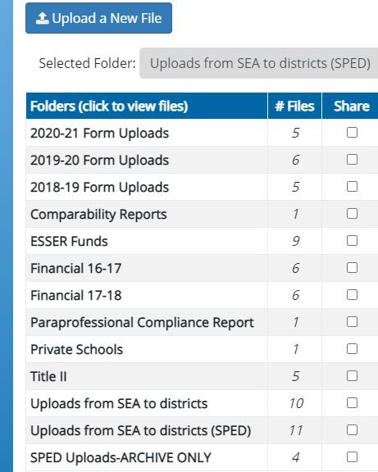
Approved Application
When an application amendment is approved by SPED Finance, the approved forms are uploaded into Indistar in the “Uploads from SEA to Districts (SPED)” folder.
This folder is for State use only. Please do not delete or add anything to this folder.
9

Slide 10
Amendments: How to Pull a COGNOS Report
When sending an amendment/COGNOS Budget Report to SPED Finance, please check the total after pulling the report.
Instructions on how to pull a COGNOS report are on the web under Funding and Finance Training material. https://dese.ade.arkansas.gov/O ffices/special-education/funding
-and-finance/finance-training-material
10

Slide 11
10% Variance Rule
Before closing the fiscal year, an amendment may be needed for the 10% Variance Rule.
Pull a COGNOS Budget and Expenditure Comparison Report II to check for the 10%.
https://dese.ade.arkansas.gov/Offices/special-education/funding-and
-finance/finance-training-material
11

Slide 12
Maintenance of Effort (MOE)
Maintenance of Effort is based on State and Local expenditures.
12

Slide 13

Maintenance of Effort (MOE)
All districts, charters and state agencies will complete the SCHOOL AGE AFR MOE Data form in MYSPED each year for the requirement of MOE.
Once districts, charters and state agencies complete Test #1 and Test
#2 of the School Age AFR MOE Data form, the other two will populate.
13

Slide 14
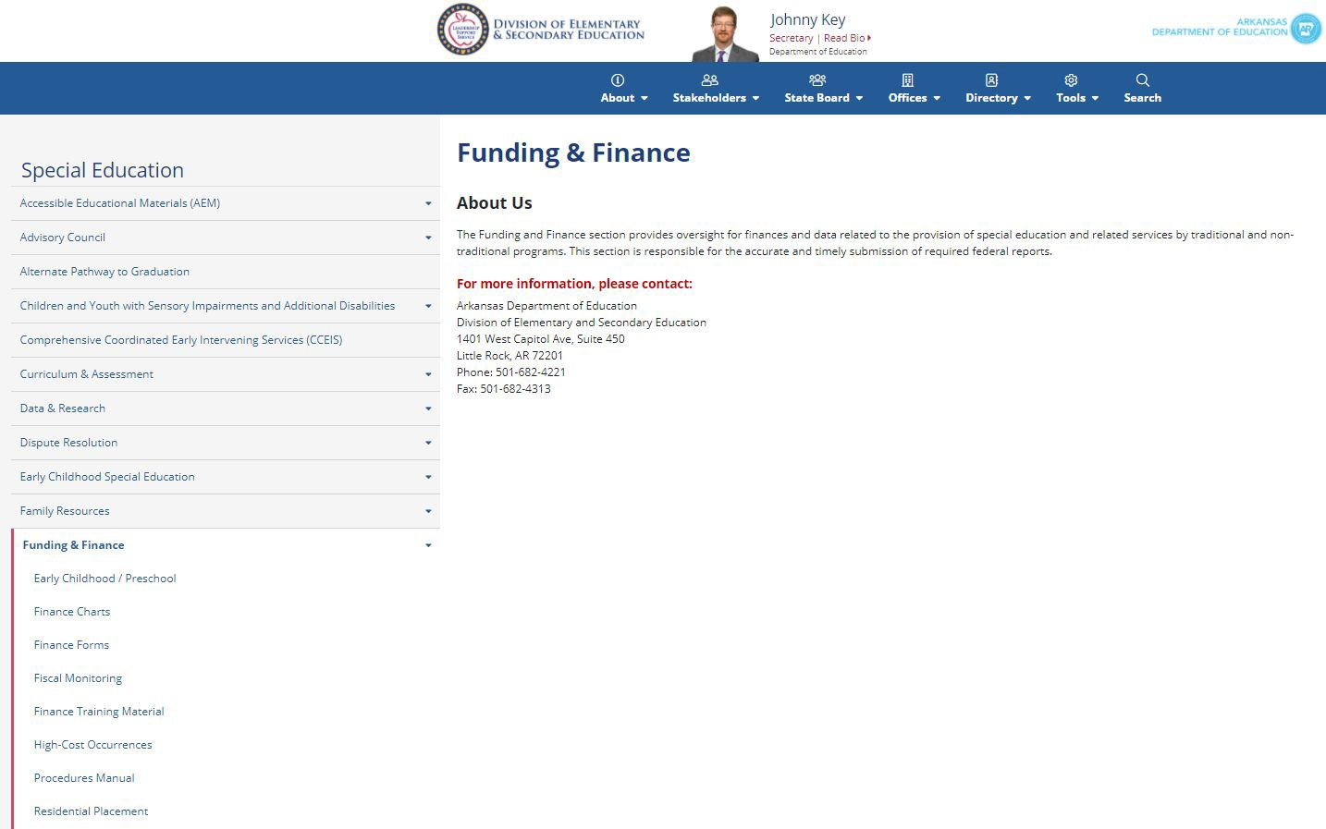
October Review of MOE
The October 1 pull of cycle 9 AFR
reports from 2023-24 are used to
confirm that districts met their
2023-24 Maintenance of Effort. The
cycle 1 budget report pull is used
to check the current 2024-25 budget for MOE requirements.
Please refer to the IDEA Part B
Fiscal Accountability Procedures
Manual posted on the web.
https://dese.ade.arkansas.gov/Offi
ces/special-education/funding-and- finance/procedures-manual
14

Slide 15
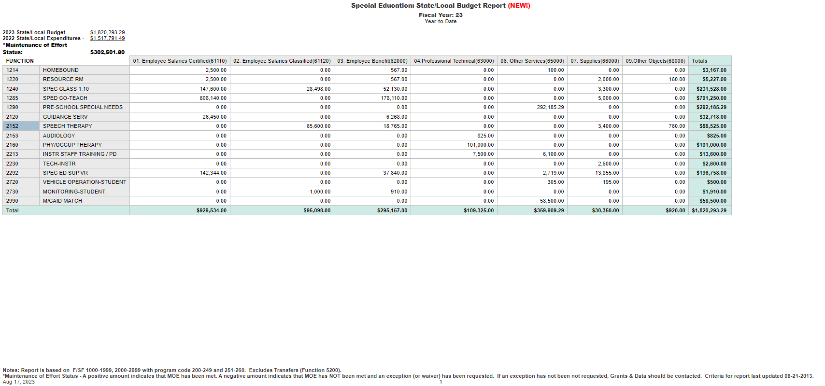
State/Local Funds for MOE
COGNOS State/Local Budget and AFR Reports are an accumulation of district and state funds using Special Education program codes to meet the Maintenance of Effort requirements.
The COGNOS State/Local NEW! Budget or AFR Report pulls these funds together for the purpose of Maintenance of Effort, Local plus State Test.
If using State/Local funds to meet Maintenance of Effort, the expenditure Budget and AFR amount must be equal to or greater than the previous year’s amount, unless allowable exceptions are entered in the appropriate AFR MOE database in MYSPED.
Reminder: Medicaid State Match (function 2990) is budgeted in State/Local in object code 65911 for Medicaid expenditures for Special Education (program code 200). If Medicaid funds are used for non-Special Education, the State Match should be prorated. Non-Special Education items should not be coded with program code 200.
Compares the budget to last year’s expenditures
This screenshot is from last year and cannot be updated until budgets are created by districts for 2024-2025.
15

Slide 16
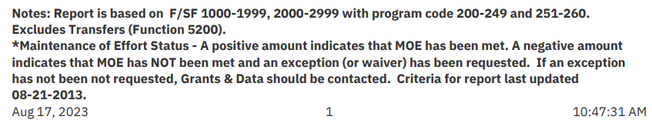
State/Local COGNOS Report
Funds/Accounts included in a COGNOS report are listed at the bottom of each COGNOS AFR and Budget Report.
Notice that State/Local reports include: 2240 (LEA Supervisor), 2244 (ESY), 2260
(State Preschool), 2262 (State EIDT Preschool), 2265 (High-Cost Occurrences) and others if a program code of 200-249 and/or 251-260 was used.
Reminder: Only program code 255 for Residential Disabled can be included in
MOE. Program codes for SPED should only be used for expenditures to support students with disabilities.
16

Slide 17
State/Local Medicaid State Match
Medicaid revenue received for vision and hearing screening for non-disabled students.
Example: A district nurse who serves all children is paid from Medicaid funds. This amount cannot be counted toward MOE.
Salary + Benefits x 29.9% (MSM rate) is used to figure the amount of MSM that is for non-disabled. This amount would be budgeted without using the 200 program code in MSM 2990 function code.
17

Slide 18
School Age AFR MOE Data Form
Located in MYSPED, the 2023-24 School Age AFR MOE Data Form is due October 15.
All 4 tests for MOE must be completed, allowable exceptions entered (if applicable) and function codes explained (if applicable).
Also located in MYSPED, the 2024-25 School Age AFR MOE Data Form is due October 31.
Include complete contact information at the top and explain function codes in Box C (if applicable).
Enter allowable exceptions in A1, A3 or A4 (if applicable).
A2 (December 1 Child Count) will automatically pull and calculate in February-March.
18

Slide 19
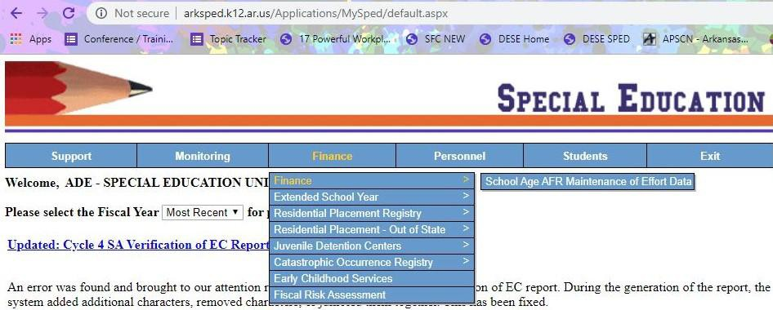
MYSPED: School Age AFR MOE Data
19

Slide 20
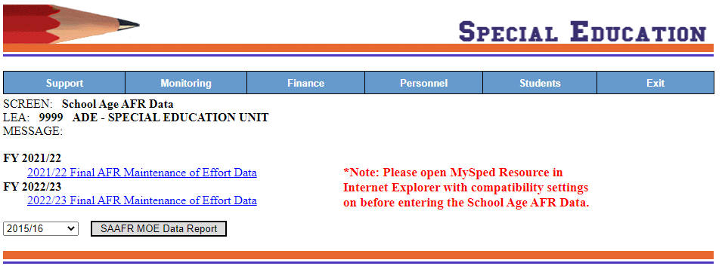
2023-24 AFR MOE Data Form
On October 16, the
2023-24 AFR MOE Data
Form will be locked.
The 2024-25 (current year) AFR MOE Data Form will be available on October 16 to enter allowable exceptions and
explain codes. Only information dealing with exceptions will be visible at this time.
MYSPED will be updated for the 2024-25 year in August.
20

Slide 21
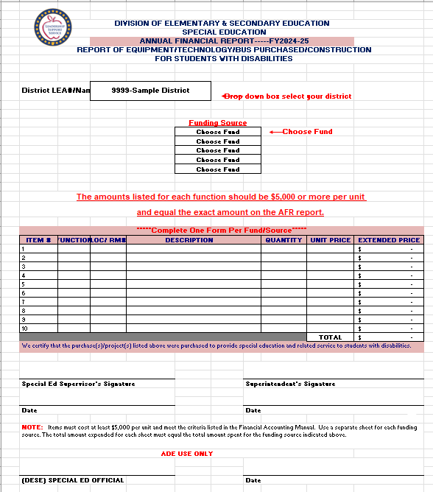
2024-25 Report Forms
The 2024-25 Report Forms are on the web under Finance Forms: https://dese.ade.arkansas.gov/Offic es/special-education/funding-and-fi nance/finance-forms.
Report forms should be emailed to SPED Finance before the October 1 deadline.
21

Slide 22
Equipment, Buses and Construction
Before a Request form for equipment, construction or purchasing a bus can be approved by SPED Finance, the amount on the Request form must be in the budget of the account listed on the Request form. Please be sure that the fund and function code in the budget match the fund and function code on the Request form.
Prior approval from SPED Finance is required for purchases of equipment $5,000.00 or more. Procedures for managing and labeling equipment are addressed on pages 15-17 of the Fiscal Accountability Procedures Manual.
Prior approval is also required for the purchase of a bus using the program code 200 or Construction/Renovation projects using the program code 200. Bus Purchase Request forms are sent by SPED Finance to the Transportation Unit for additional approval. Construction projects, if $35,000.00 or over, are also sent by SPED Finance to be additionally approved by the Facilities Unit. All playground equipment must be approved by SPED Finance.
22

Slide 23
Coding for Equipment, Bus, Construction/Playground
For Equipment ($1,000 per item or more), please budget in the appropriate function code and use object code 67000.
For Construction/Playground equipment, please use budget function code 4710 (Instructional areas) or 4720 (Non-instructional areas) and object code 64000.
For purchasing a bus, please use budget function code 2720 and object code 67000.
23

Slide 24
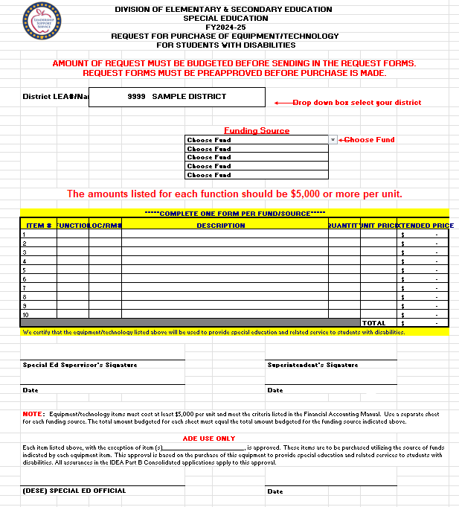
2024-25 Request Forms
Districts can find the 2024-25 Request forms are on the web under Finance Forms: https://dese.ade.arkansas.gov/Off ices/special-education/funding-an d-finance/finance-forms.
24

Slide 25
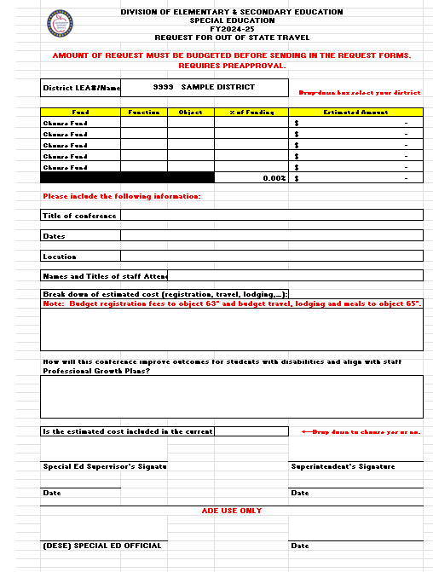
2024-25 Request Forms Out-of-State Travel
25

Slide 26
Request Approvals
When a request form is approved, the signed form will be emailed back.
26

Slide 27
How to Code IDEA Part B Revenue for June 2024 Expenditures
Districts expecting reimbursement for June expenditures for IDEA Part B should accrue revenue as follows:
If the district had a negative balance of $100,000 for IDEA Part B
funds (F/S 6702) on the board report on June 30 (end of Period 12 or 13 of FY 2024), the correct entry would be:
Debit 6702 – 01410 (Intergovernmental Receivables)
$100,000
Credit 6702 – 45613 (Title VI-B Revenue) $100,000
*Note: This amount of revenue CANNOT cause the Year-to-Date (YTD) revenue for the district to exceed the total funds available. If this occurs, expenditures MUST be moved from F/S 6702 to other sources.
27

Slide 28
How to Code IDEA Part B REVENUE For June 2024 Expenditures
On or after July 1, 2024 (during Period 1 of FY 2024-25), the correct entry is:
• Debit 6702 – 45613 (IDEA Part B Revenue) $100,000
Credit 6702 – 01410 (Intergovernmental Receivable) $100,000
When the money is received, it is receipted as normal revenue with a CR to revenue and a DR to cash. This is the preferred method by ADE and Audit.
• Debit 6702 – 01010 (CASH) $100,000
Credit 6702 – 45613 (IDEA Part B Revenue) $100,000
28

Slide 29
Prepping for the October 1, 2024 Amendment Deadline
July/August:
Commissioner’s Memos (2023-24 Carryover and 2024-25 Allocation)
Add the 2023-24 Cash on Hand and Carryover, the 2023-24 Additional Reserve and 2024-25 preliminary allocation for the October 1 budget total.

Slide 30
Reports: Prepping for the October 1 Amendment Deadline
2023-24 COGNOS AFR (Expenditure) Report (YTD)
State/Local
IDEA Part B
PSPS (if applicable)
CCEIS/CEIS (if applicable)
Federal Preschool
State Preschool
State EIDT Preschool
Report of Equipment/Bus/Construction Purchased forms
2024-25 COGNOS Budget Report NEW (YTD)
State/Local
IDEA Part B
PSPS (if applicable)
CCEIS/CEIS (if applicable)
Federal Preschool
State Preschool
State EIDT Preschool
Request to Purchase Equipment/Bus/Construction forms

Slide 31
September

Slide 32
Prepping for the October 1, 2024 Amendment Deadline
The October 1 State/Local budget should be based on expected expenditures. The LEA and bookkeeping department should keep expenditures as closely aligned to this budget as possible for purposes of MOE.
The October 1 IDEA Part B budget IS NOT entered in Indistar. It is entered in eFinance by the bookkeeper.
The October 1 budgets are entered by the district bookkeeper in eFinance. The LEA and bookkeeper should agree on the total amount and budget contents. Please compare classroom function codes to classroom ratios.
When changes to the budgets are needed, a budget amendment (COGNOS Budget Report) should be emailed to SPED Finance.

Slide 33
Prepping for the October 1, 2024 Amendment Deadline
The October 1, 2024 IDEA, Part B budget is an FY 24-25 preliminary budget.
SPED Finance pulls the cycle 1 2024-25 COGNOS Budget Reports and the cycle 9 2023-24 AFR (expenditure) Reports for State/Local, IDEA Part B (both Section 611 School Age and Section 619 Federal Preschool), State, and State EIDT Preschool.
After October 1, submissions are pulled from the system, and SPED Finance will check budgets for:
Correct total funds available amount;
Appropriate function and object codes;
If monies are budgeted in a reasonable manner;
MOE for year 2023-24 and current year 2024-25; and
Request/Report forms.

Slide 34
School Age AFR MOE Data Form
Located in MYSPED, the 2023-24 School Age AFR MOE Data form is due October 15.
Also located in MYSPED, the 2024-25 School Age MOE AFR Data form is open October 16 and due before November 15.
All districts, state agencies and charters must complete this form online.

Slide 35
Federal and State Preschool
The district must submit a budget for Federal, State, and State EIDT Preschool by the October 1 deadline.
If a charter receives Preschool funds for 5-year-olds in Kindergarten, the charter must submit a budget for Federal, State, and State EIDT Preschool by the October 1 deadline.

Slide 36
Federal and State Preschool
Federal (6710), State (2260), and State EIDT Preschool (2262) allocations for 2024-25 are also announced by Commissioner’s Memo.
2023-24 carryover amounts and 2024-25 preliminary allocation amounts should be combined for Total Funds Available.
Expenditure budgets for both Federal, State, and State EIDT Preschool should be entered into eFinance before October 1.

Slide 37
October 1 Deadline: Coding
It is important to use the correct function and object codes for Special Education budget/expenditures. Please use the following references:
A reference list of commonly used codes is found on the Training Material webpage.
https://dese.ade.arkansas.gov/Offices/special-education/funding-and
-finance/finance-training-material
The Arkansas Financial Accounting Handbook is the official handbook for coding, available on APSCN.org. http://www.apscn.org/fms/fmsmain.htm
For this hyperlink, if it asks for a username and password, the username is apscn and the password is docs.

Slide 38
Due Before October 1
Consult Commissioner’s Memos for IDEA Part B and Federal, State, and State EIDT Preschool to establish totals.
All budgets entered in eFinance: State/Local, IDEA Part B, Federal, State, and State EIDT Preschool.
Complete two forms in MYSPED: 2023-24 AFR MOE Data form before October 15. Between October 16 and October 31, complete the 2024-25 AFR MOE Data form.

Slide 39
Are You a New LEA?
Things to Consider
Does the district intend to apply for ESY reimbursement? Read the ESY guide on the web.
If the district has SPED students in a Residential Facility, read the training material on the web. Be sure SPED funds are only paying for students with disabilities.
Will the district be filing for High-Cost Occurrences (formerly known as Catastrophic)? Training and materials will be announced this Fall. The Registry opens December 2 and closes on January 31. March 18 is the deadline for submission of claims.
Is the district on the 2024-25 list for fiscal and program monitoring?

Slide 40
SPED Finance Forms
Remember
The 2023-24 Report Forms and the 2024-25 Request Forms can be found on the web under Finance Forms: https://dese.ade.arkansas.gov/Offices/special-education/funding-and-finance/finance-forms.

Slide 41
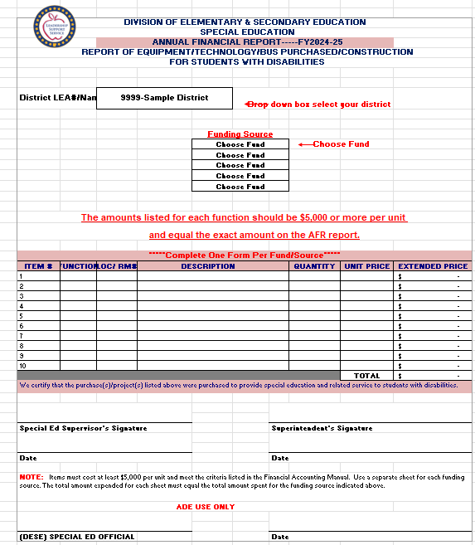
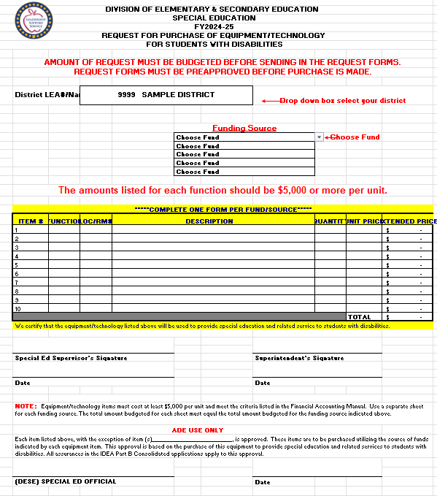
Report and Request Forms

Slide 42
2024-25 Budgets
Reports needed for the October 1 deadline
Maintenance of Effort (State/Local accounts)
Initial Budgets
SPED Finance Monitoring
Request and Report Forms for Purchases

Slide 43
LEA Special Education Supervisor Funding
(1240 & 2240)
Supervisor funds must be coded to Fund/Source (F/S) 2240 and revenue code 32310.
These funds can be used for salaries and benefits of special education supervisors (or the purchase of the services of a supervisor).
Expenditures from the current or carryover funds should be coded F/S 1240 or F/S 2240.
State/Local or IDEA Part B funds can be used to support LEA Supervisor salaries and benefits.

Slide 44
Extended School Year (ESY) Services
(1244 & 2244)
Two payments will be made:
Part I
For services from end of school year through June 30, 2024, reimbursed in August.
Superintendent’s Certification due July 22, 2024.
Part II
For services after July 1, 2024, reimbursed in September or October.
Superintendent’s Certification due September 16, 2024.

Slide 45
Budgeting IDEA, Part B
Look at the previous year’s COGNOS AFR expenditure report for a guide.
Budget the amounts from the Carryover Memo and the Allocation Award Memo to the penny.
Bookkeeper and LEA should work together on the budget.
Include the Private School Proportionate Share, if applicable.
https://dese.ade.arkansas.gov/Offices/special-education/funding-and-finance/finance-charts
Include CCEIS/CEIS, if applicable. https://dese.ade.arkansas.gov/Offices/special-education/funding-and-finance/finance-charts
Consult the Procedures Manual for allowable/non-allowable expenditures.
https://dese.ade.arkansas.gov/Offices/special-edu cation/funding-and-finance/procedures-manual

Slide 46
Private School Proportionate Share
Districts with parentally placed private/home school students must set aside the required amount in the October 1, IDEA Part B budget.
Districts report a number of parentally placed private/home school students on the Private School Survey in MYSPED each December.

Slide 47
Private School Proportionate Share Current Year
The Private School Proportionate
Share should be calculated for 2024-25 using the December 1, 2023 Child Count and the number of Private and Home school students reported on the 2023-24 Private School Survey (Question #4, #5, #6, and #7).
A Preliminary PSPS chart for
2024-25 is posted on the web page.
https://dese.ade.arkansas.gov/Offices/special-ed ucation/funding-and-finance/finance-charts
Please use the chart to determine the amount needed for the October 1 amendment.
There are 4 allowable function codes for use with PSPS: 1218, 1228, 2158, 2168.
Program codes for PSPS are 266 for Carryover and 268 for Current year.

Slide 48
Private School Proportionate Share Carryover (previous year)
The amount in PSPS program code 268 for 2023-24 that was not spent must be carried over in 2024-25 in program code 266.
The amount of the 2023-24 Additional Reserve (Funding Source
should be included for PSPS and be budgeted in carryover program code 266.
The PSPS adjustment from the 2023-24 Preliminary allocation and
the 2023-24 Final allocation will also be budgeted in program code 266 for carryover.
A PSPS Carryover Worksheet will be posted to help figure the PSPS carryover amount. https://dese.ade.arkansas.gov/Offices
/special-education/funding-and-financ e/finance-charts
There are 4 allowable function codes for use with PSPS: 1218, 1228, 2158, 2168.
Program codes for PSPS are 266 for Carryover and 268 for Current year.

Slide 49
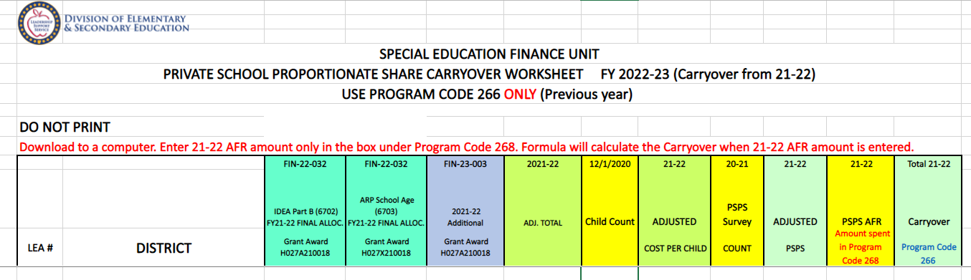
Carryover PSPS worksheet
A worksheet for calculating an adjusted cost per child and unspent carryover will be available on the web.
https://dese.ade.arkansas.gov/Offices/special-education/funding-and-finance/finance-charts
PSPS Chart will be updated after the 2024-25 Carryover and Cash on Hand are released.

Slide 50
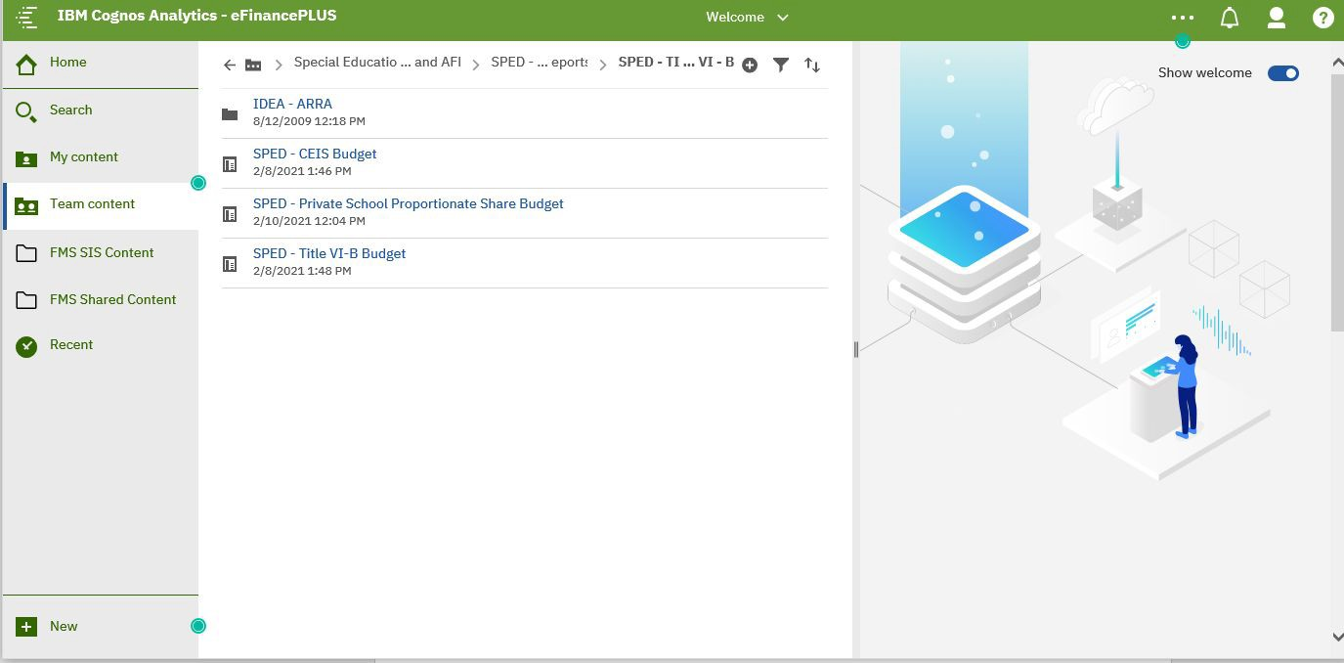
Private School Proportionate Share
Please pull a COGNOS PSPS budget report to check for accuracy of program codes before the October 1 submission and when amending.

Slide 51
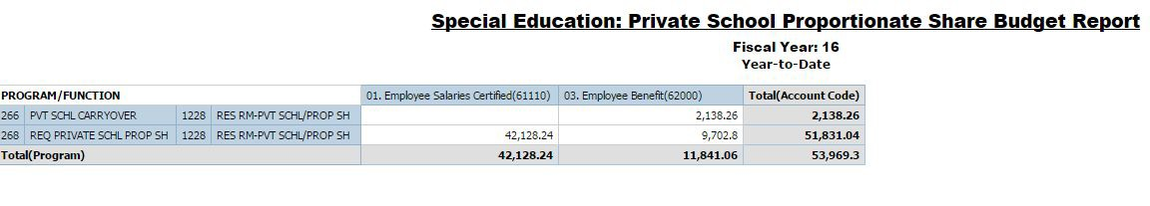
Private School Proportionate Share COGNOS Budget Report

Slide 52
Medicaid State Match
All districts who receive Medicaid reimbursement MUST pay the 29.9% state match.
If contracting services for OT, PT or Speech and contractors complete the Medicaid billing, the district still pays the Medicaid State Match. Contractors must bill using the school code for the district to ensure it comes through on the Medicaid explanation of benefits.
Check your contracts for pertinent information.
Require contractors to sign in when providing services, provide a copy of progress notes, and indicate why they may not have seen a student.

Slide 53
Medicaid Offset in High-Cost Occurrences
When filing for High-Cost Occurrences (formerly known as Catastrophic Occurrences), the Medicaid offset should reflect what the district is expected to receive the entire year.
The Medicaid offset should be reasonable based on other Medicaid information listed in the claim.

Slide 54
Legal Expenses
Legal expenses, including attorney fees and other related hearing expenses, may NOT be included when calculating a district’s Maintenance of Effort (MOE).
As stated in the relevant federal regulation, 34 CFR § 300.203, an LEA complies with the MOE requirements, “if the LEA budgets, for the education of children with disabilities, at least the same total or per capita amount … as the LEA spent for that purpose … for the most recent prior year for which information is available.”
The education of children with disabilities includes special education and related services as defined in federal regulations, 34 CFR §§ 300.34 and
300.39. Neither legal fees nor attorney fees are included in either definition
and therefore, may not be included in a district’s calculation of MOE.

Slide 55
2023-24 AFR Maintenance of Effort Data
Data Form must be completed by the end of September and is due October 15.
Click on Finance in MYSPED, then Finance/School Age AFR Maintenance of Effort Data.

Slide 56
2023-24 AFR MOE Data
Choose the 2023-24 form and complete all 4 MOE Tests and list exceptions, if exceptions apply.
Explain any codes needed in Box C.
After June 30, but before closing the year, it is the responsibility of the district to update the Departure of Staff amounts entered into the School Age AFR Data Form in MYSPED and send updated Detailed Distribution Reports to SPED Finance for approval.

Slide 57
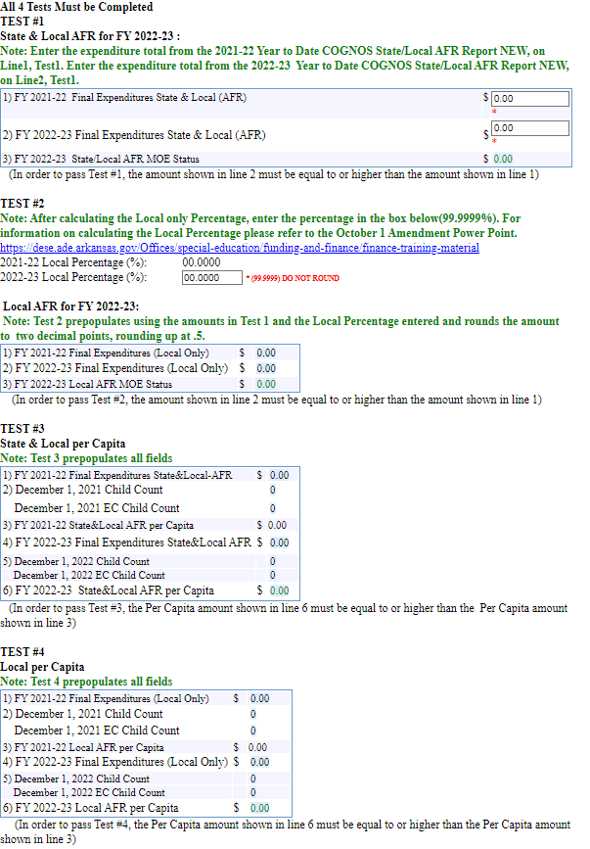
2023-24 AFR MOE Data
The AFR MOE Data form/database houses the district contact information and the 4 Tests for MOE.
It is important to check for accuracy when entering any and all information.

Slide 58
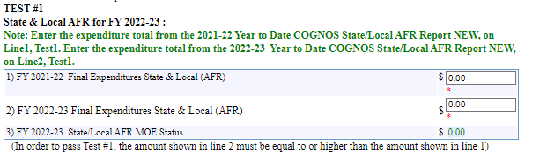
2023-24 AFR MOE Data: Test #1
Test #1, line 1 asks for the final
expenditure amount for 2022-23,
since this is the amount that must
be met for Maintenance of Effort for 2023-24.
Test #1, line 2 asks for the final expenditure amount for 2023-24.
Line 3 will calculate.
In order to pass Test #1, the amount
in line 2 must be equal or more
than line 1 (unless allowable
exceptions have been entered in A1-A4).

Slide 59
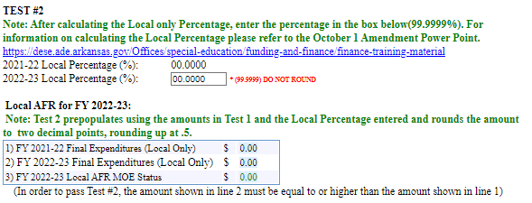
2023-24 AFR MOE Data: Test #2
Test #2 requires the pulling of reports and some calculation before entering a Local Percentage.
When the Local Percentage is entered, the rest of Test #2 will pre-populate using the information entered in Test #1 and the Local Percentage.

Slide 60
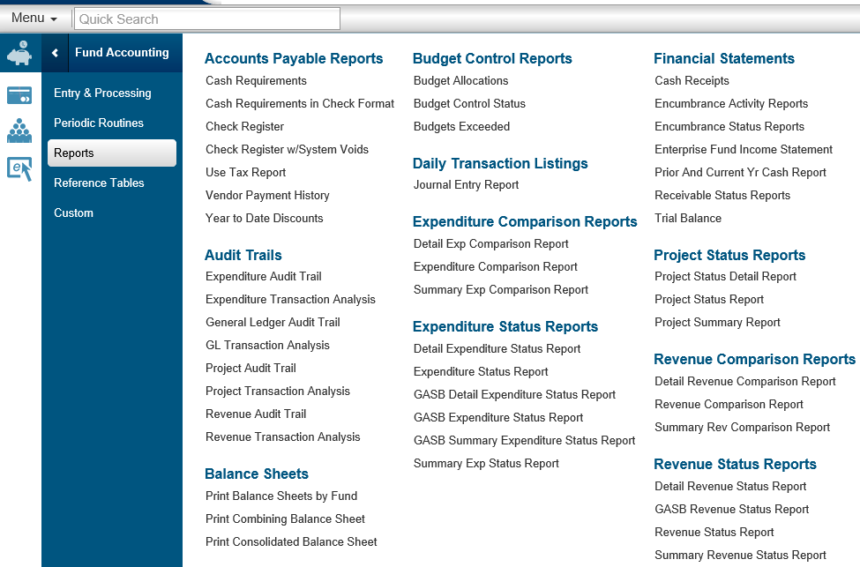
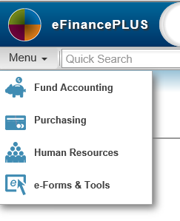
Pulling the Local Revenue Report
Pull a Summary Revenue Status Report (Board Format) for local revenue account numbers. See screen shots below.

Slide 61
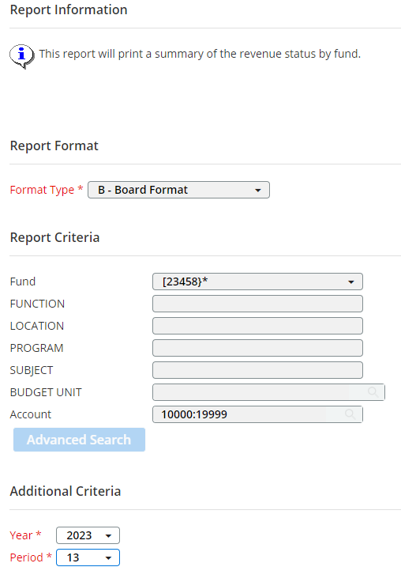
Screen Shot for the Local Revenue Report
[23458 ]* Fund: brackets
10000:19999

Slide 62
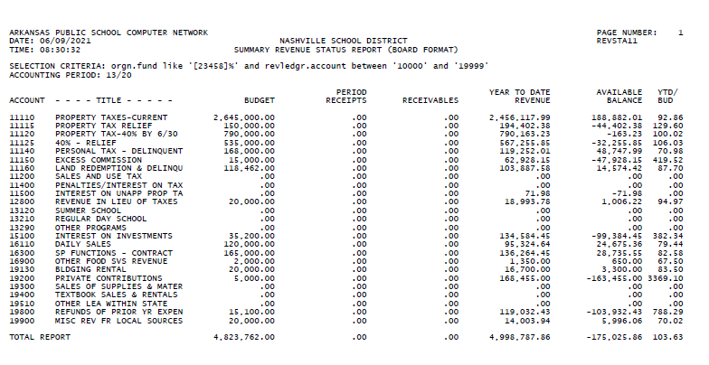
Local Revenue Report
13/22

Slide 63
Pulling the State Revenue Report
Pull a Summary Revenue Status Report (Board Format) for local revenue account numbers. See screen shots below.

Slide 64
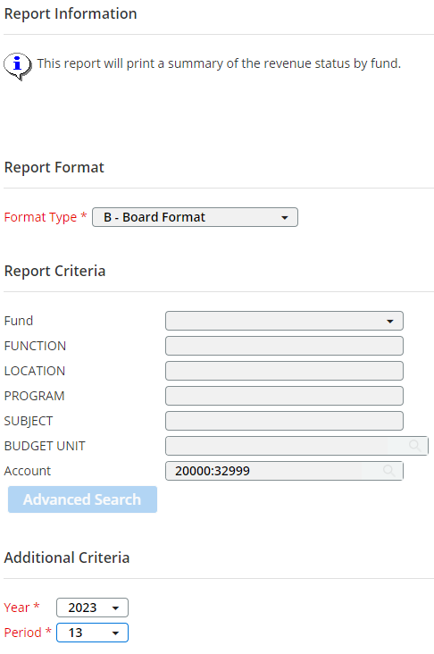
Screen Shot for the State Revenue Report
Pull the Summary Revenue Status Report (Board Format) for State revenue account numbers. See Screen shots for account numbers.
20000:32999

Slide 65
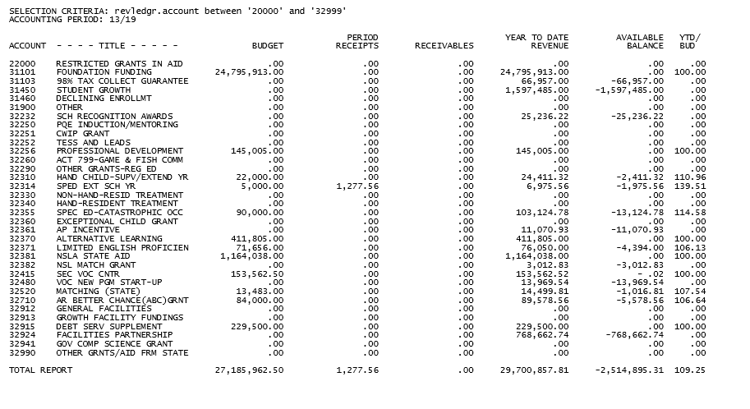
State Revenue Report
13/22

Slide 66
YTD Revenue Total
Locate the YTD Revenue column in both reports. Add the two totals together to get a total revenue amount.
Local Revenue | 4,998,787.86
State Revenue | 29,700,857.81
Total | 34,699,645.67

Slide 67
Finding the Local Percentage
Divide the Local revenue YTD total by the Total revenue amount from both revenue reports.
Set the calculator decimal for 4 places.
This should give you a percentage with 4 places past the decimal point.
DO NOT ROUND
4,998,787.86 / 34,699,645.67=14.4059%
Use the Percentage key

Slide 68
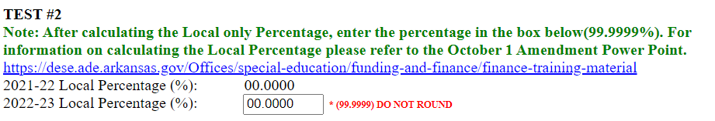
MOE Test #2 Local Percentage
Enter the Local Percentage (example) into MOE Test #2 of the 2023-24 AFR Data form in MYSPED.
Users must enter all 4 numerals past the decimal point for the form to calculate correctly. Do Not Round.
When the Local Percentage is entered, the remainder of the MOE Tests will prepopulate and calculate.

Slide 69
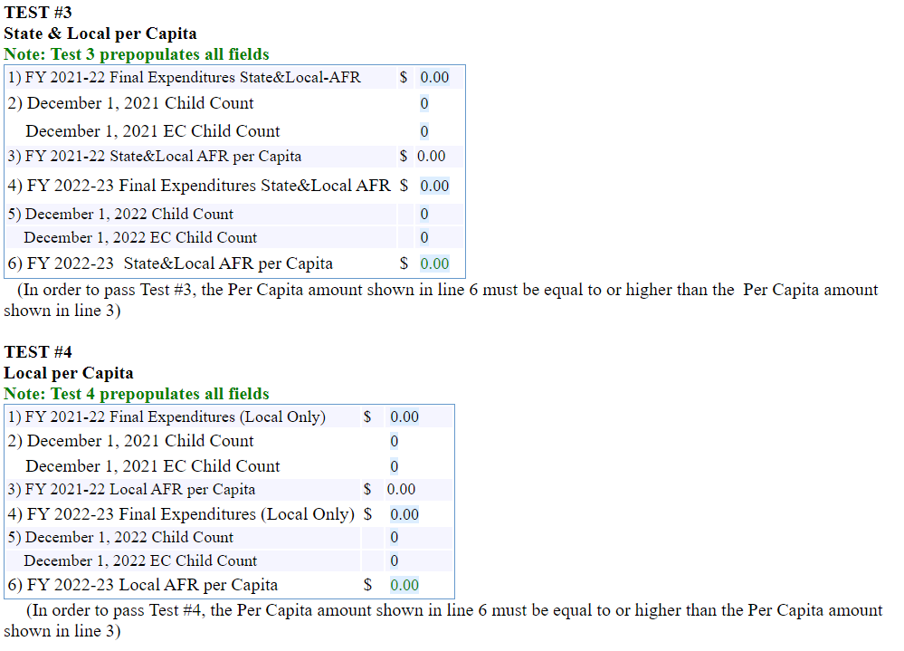
2023-24 AFR MOE Data
Tests #3 and #4 populate using information entered in Test #1 and Test #2.
The question below Test #4 asks that the district choose only one Test for meeting MOE.

Slide 70
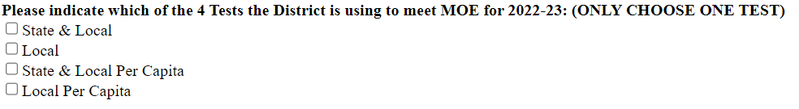
Test for Meeting MOE
Below Test #4, the user should indicate which MOE Test the District is using for 2023-24.

Slide 71
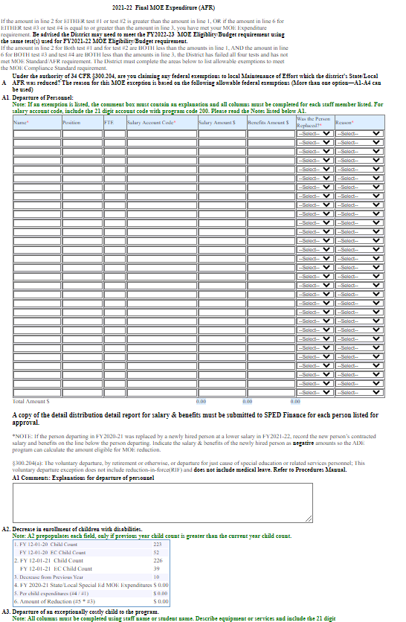
2024-25 AFR MOE Data: Exceptions
Allowable exceptions for Maintenance of Effort are listed as A1-A4.
Comment boxes under each exception are required if information is entered.
Exceptions must be explained in detail.

Slide 72
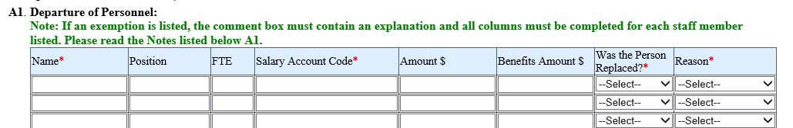
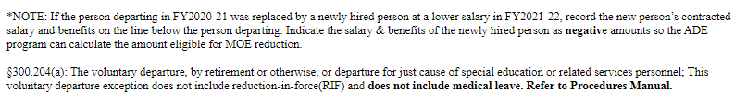
2023-24 AFR MOE Data: A1
A1 Departure of Personnel: Voluntary
departure by retirement or otherwise or departure for just cause.
If the person departing in 2022-23 was
replaced by a newly hired person at a
lower salary in 2023-24, record the
new hire’s contracted salary and
benefits on the line below the person
departing and indicate a negative with
a minus sign before the salary and benefits amount.
The system will then calculate the
difference in the two salaries for the exception amount.

Slide 73
A1 Example
34 CFR 300.204(a)– “ The voluntary departure by retirement or otherwise, or departure for just cause, of special education or related services personnel.” A RIF is not a voluntary departure, nor is it departure for just cause. Just cause is a “term of art” in the HR world and generally refers to dismissal for some form of misconduct or breach of contract. Asking a teacher not to come back is also not voluntary departure. A teacher retires-voluntary departure. Another teacher gets a better paying job across the State
line—voluntary departure. Additional, if a teacher voluntarily departs and the
position is filled by a lower-paid new hire, the difference between the departing teacher’s salary and the new hire’s salary can reduce the MOE.
OSEP Vetted Examples 34 CFR 300.204

Slide 74
Documentation for A-1:
Departure Of Staff
For each staff member listed in A1 Departure of Staff, a Detailed Distribution Report from eFinance is required as documentation of the contract salary and benefits amount (not salary for extra duties beyond the contract) listed in the exception. Salary for “Sick Days” at retirement is not allowable.
Email the
Detailed Distribution Report showing the total salary and benefits amount paid
to the employee listed as leaving the district. Also the Detailed Distribution Report showing the salary and benefits amount paid (or to be paid) to the newly hired staff member. SPED Finance email addresses are on the last slide.
After June 30, but before closing the year, it is the responsibility of the district to update the Departure of Staff amounts entered into the School Age AFR Data Form in MYSPED and send updated Detailed Distribution Reports to SPED Finance for approval.

Slide 75
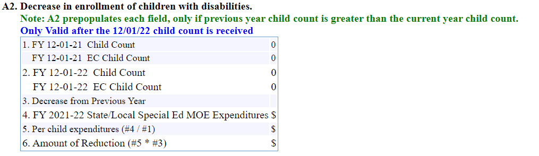
2023-24 MOE Data : A2
A2 Child Count: Decrease in enrollment is pulled from the system and pre-populated. If line 6 (amount of reduction) is blank, there is no child count reduction.

Slide 76
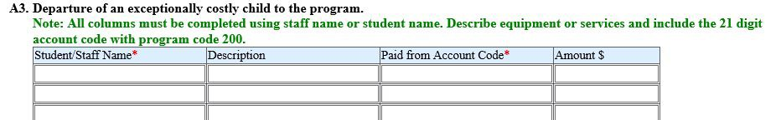
****2023-24 AFR MOE Data: A3-A4
Exceptions A3 and A4 are one time expenditures from 2022-23 that did not occur in 2023-24.
A3 expenditures are tied to a student that left in 2022-23.
A4 expenditures are costly items such as equipment purchased in the 2022-23 year that did not occur again in 2023-24.

Slide 77
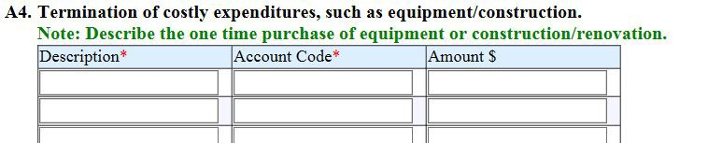
Changes for A4 Exceptions
Exception A4: A one-time expense, such as equipment/construction, must be paid over a multi-year period. The amount paid in the final year is the amount allowable for exception 34 CFR 300.204(d). The expense must be greater than the federal microtransaction threshold of $10,000.00.

Slide 78
A4 Example
34 CFR 300.204(d) “The termination of costly expenditures for long term purchases, such as the acquisition of equipment or the construction of school facilities.” You are expending funds against a 2-year construction contract to retro-fit and renovate a building, including ramps, chair lift, accessible bathrooms, etc. The contract is
$90,000 a year for each of the two years ($180,000). At completion of the contract, you can reduce your MOE by $90,000.
OSEP Vetted Examples 34 CFR 300.204

Slide 79
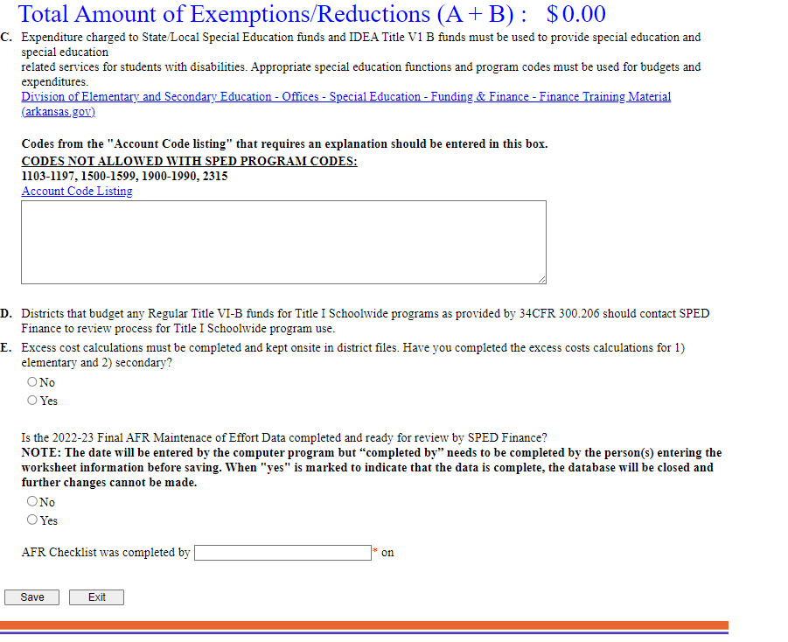
2023-24 AFR MOE Data
The data form continues to ask for an
explanation of expenditures in selected codes
used in State/Local AFR, IDEA Part B AFR, Federal, State, and State EIDT Preschool AFR reports.
As a reminder, the form asks if Excess Cost has been completed (question E).
Always click SAVE before exiting the database.
Click SAVE when information is completed. Error
messages only appear on a SAVE. Only one error message at a time will appear on each SAVE.
Clicking YES on the last question will lock the form. To unlock a form, please call SPED Finance.
•
All districts, charters and state agencies must click YES on the last question before October 15.

Slide 80
EOY Maintenance of Effort
At the beginning of the 2024-25 fiscal year, the Maintenance of Effort is
based on the COGNOS State/Local Budget report. However, in the Spring,
districts should approach the MOE by looking at the COGNOS State/Local
AFR (expenditure) report.
https://dese.ade.arkansas.gov/Offices/special-education/funding-and-finance/finance-training-material
Maintenance of Effort is met with State/Local expenditures and/or allowable exceptions.
If a district’s State/Local expenditures (for SPED) are not meeting MOE, the
district should move SPED expenditures (program code 200) from IDEA Part B,
into a State/Local account BEFORE CLOSING THE FISCAL YEAR.
If the district has a
preapproved allowable exception listed in MYSPED
(School Age AFR MOE Data form), the amount of the exception can be used to reduce the Maintenance of Effort.

Slide 81
Effective July 1, 2015 Non-Regulatory Guidance
Eligibility Standard (Budget)
The eligibility standard in 300.203(a) requires that, in order to find an LEA eligible for an IDEA Part B subgrant for the upcoming fiscal year, the State must determine that the LEA has budgeted for the education of children with disabilities at least the same amount of local or State and local funds, as it actually spent for the education of children with disabilities during the most recent fiscal year for which information is available.
Compliance Standard (AFR)
The compliance standard in 300.203(b) prohibits an LEA from reducing the level of expenditures for the education of children with disabilities made by the LEA from local, or State and local, funds below the level of those expenditures from the same source for the preceding fiscal year. In other words, an LEA must maintain (or increase) the amount of local, or State and local, funds it spends for the education of children with disabilities when compared to the preceding fiscal year.

Slide 82
Maintenance of Effort
Eligibility Standard
At the beginning of each year, MOE for the current year is based on the State/Local budget.
The October 1 State/Local COGNOS budget must budget at least the amount that was spent last year (unless allowable exceptions).
Compliance Standard
Maintenance of Effort is met with expenditures (for SPED) in State/Local accounts (designated with a program code 200) at the end of the year.
Districts must spend at least what was spent the prior year (for SPED) in State/Local accounts or have federally allowable exceptions that reduce the MOE.

Slide 83
October - November

Slide 84
Excess Cost
Beginning in 2023-2024 Excess Cost is calculated by DESE-OSE and documentation of meeting the requirement is kept internally.
If the LEA does not meet Excess Cost initially DESE-OSE will notify the SEA and work with the LEA to capture any additional expenditures to assist in meeting the Excess Cost requirement.

Slide 85
Fiscal Monitoring Cycle
A four-year monitoring cycle that
aligns with the Special Education
program monitoring cycle has been implemented.
The Fiscal Monitoring Protocol is
available on the web:
https://dese.ade.arkansas.gov/Offices
/special-education/funding-and-financ e/fiscal-monitoring
The Monitoring Cycle calendar is
available at the following link:
https://dese.ade.arkansas.gov/Offices
/special-education/monitoring-and-pr
ogram-effectiveness/monitoring-proc edures

Slide 86
Fiscal Monitoring Cycle
Time certification forms or “Time Distribution Records” are required for all Federal employees:
Full-time federal employees require certification forms to be completed two times per year.
Employees who work in more than one federal program or work part-time in a federal program and part-time in a state, local or other program, require time sheets for split positions. These forms are to be completed each month the employee works.
https://dese.ade.arkansas.gov/Offices/special-education/funding-and-finance
/finance-forms

Slide 87
Fiscal Monitoring
FINDINGS:
FINDINGS:
PURCHASING EQUIPMENT WITHOUT PRIOR APPROVAL
TIME CERTIFICATION
GIFTS, GIFT CARDS
GRADUATION ITEMS
DECORATIONS
ENTIRE COST OF FIELD TRIPS
REFRESHMENTS/SNACKS
MONTHLY SERVICES SUCH AS PEST CONTROL, WATER COOLER, COFFEE, FRAGRANCE, ETC.
MEALS/SNACKS FOR STAFF
FLORIST ITEMS
FOOD/GROCERY ITEMS THAT DO NOT MEET ALLOWABLE CRITERIA
CLOTHES: GROUP T-SHIRTS, ETC.
TOYS
SUPPLANTING ISSUES WITH CONSTRUCTION PROJECTS
CANNOT RUN A BUSINESS OUT OF THE GRANT: PURCHASING ITEMS TO SELL FOR A FUNDRAISER OR FOR PROFIT (BAKE SALES, COFFEE CARTS, ETC.)

Slide 88
Contracts with Providers
Monthly progress notes and attendance records should be compared to the invoice before payment is made.
Turnaround for reports
Renewed annually
Termination clause
Current Licensure
Liability Insurance
ESY, if applicable
Suspended, de-barred
Date of school year/fiscal year
Confidentiality
HIPPA-FERPA
Can include provision around inclusive practices

Slide 89
December

Slide 90
Private School Survey
The Private School Survey is required for all districts. The survey is necessary to ensure that all private school or home school students that have been identified as needing special education and/or related services are included in the calculation of Private School Proportionate Share.
Private school AND/OR home school students that were:
being served; or
identified as needing special education and/or related services as of December 15, 2024, should be included in this survey.

Slide 91
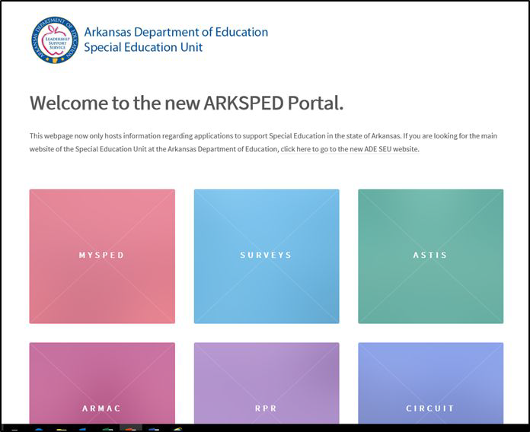
Private School Survey
The Private School Survey will open December 1, 2024,
and must be completed online by December 15, 2024.
The completed survey should be printed after submission. Please email or fax to: spedfinance.indistar@ade.arkansas.gov
Fax: 501-682-4313

Slide 92
High-Cost Occurrences
(formerly Catastrophic Occurrences)
Refer to High-Cost Occurrences Funding Guide posted on web: https://dese.ade.arkansas.gov/Offices/special-education/funding-an d-finance/high-cost-occurrences

Slide 93
January - February

Slide 94
March - May

Slide 95
High-Cost Occurrence Registry
Registry closes on January 31st for student data transfer. Students will not be able to be ADDED in MySped HCO Registry after the closure.
HCO Registry reopens February 7th.
HCO Registry closes on March 18th . No student data entry is allowed after this date.
NEW:
All LEAs will utilize the High-Cost Occurrence Calculation Sheet created by DESE-OSE to assist in accurate cost calculations, increase efficiency at the LEA level, and allow for a better turn around in processing all HCO claims and sending out reimbursements to the LEA.
All LEAs will submit 1 IEP for every 10 claims by March 18th to the DESE-OSE. The highest value claim is a required submission. This will assist DESE-OSE in reviewing and approving claims.

Slide 96
Comprehensive Coordinated Early Intervention Services (CCEIS) and Coordinated Early Intervention Services (CEIS)
CCEIS/CEIS are services provided to students in kindergarten through grade 12 (with a particular emphasis on students in kindergarten through grade three) who are not currently identified as needing special education or related services, but who need additional academic and behavioral supports to succeed in a general education environment.

Slide 97
CCEIS & CEIS
REQUIRED - CCEIS
VOLUNTARY - CEIS
Under 34 CFR §300.646(b)(2), if a State identifies significant disproportionality based on race or ethnicity in an LEA with respect to the identification of children as children with disabilities, the identification of children in specific disability categories, the placement of children with disabilities in particular educational settings, or the taking of disciplinary actions, the LEA must use the maximum amount (15 percent) of funds allowable for comprehensive CEIS for children in the LEA, particularly, but not exclusively, for children in those groups that were “significantly over-identified.”
LEAs not identified as having significant disproportionality may voluntarily set aside up to 15% of Part B funds for CEIS.
CIFR Quick Reference Guide for CEIS is available at:
https://cifr.wested.org/wp-content/uploads/2015/12
/CIFR-CEIS-QRG.pdf

Slide 98
Coordinated Early Intervention Services
The CCEIS/CEIS allowable percentage is taken from the IDEA Part B 2023-24 allocation amounts of both Section 611 School Age and Section 619 Preschool. Allowable CCEIS/CEIS percentages will be posted on the SPED website.
https://dese.ade.arkansas.gov/Offices/special-education/funding-and-finance/fin
ance-charts
Remember to use function code 1297 for CCEIS/CEIS budget and expenditures with appropriate program codes:
VOLUNTARY: CEIS: Program code 264 Carryover and 265 Current Year
REQUIRED: CCEIS: Program code 267 Carryover and 269 Current Year

Slide 99
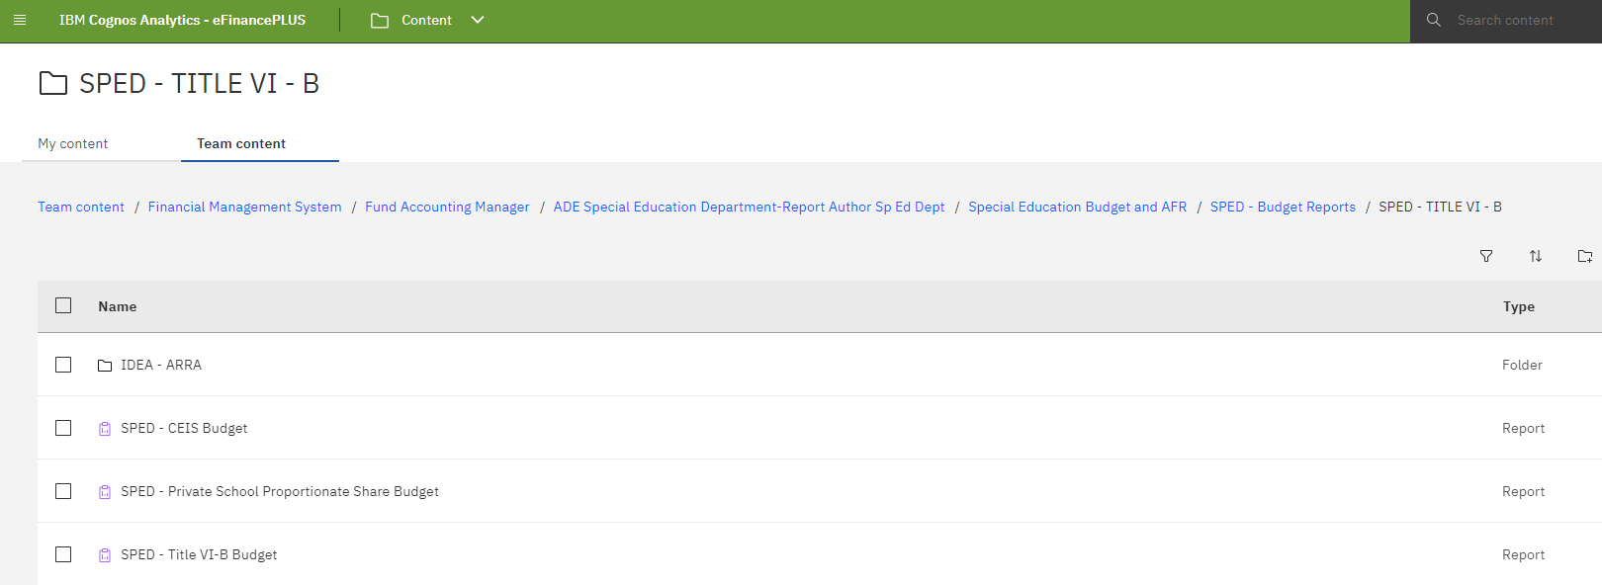
Coordinated Early Intervention Services
Please pull a COGNOS CCEIS/CEIS Budget report before October 1 to check the accuracy of program codes.

Slide 100
Coordinated Early Intervention Services
If a district did not receive approval for CCEIS/CEIS on the 2024-25 March Application, the district must submit a CCEIS/CEIS application for approval to SPED Finance.
The CCEIS/CEIS application forms are available on the website: https://dese.ade.arkansas.gov/Offices/special-education/comprehen sive-coordinated-early-intervening-services-cceis.

Slide 101
Spring Final Amendment Allocations
In the Spring, the final IDEA Part B and Federal, State, and State EIDT Preschool Allocations are announced in Commissioner’s Memos. June 6, 2025 is the deadline for adjusting the IDEA Part B and Preschool budget totals in eFinance.
These adjustments are amendments to the budget that are entered into eFinance. Please email your assigned person in SPED Finance when these are completed.
100

Slide 102
Spring and End of Year
Adjust IDEA Part B, Federal, State, and State EIDT Preschool Budgets to Final Allocation Memo
If adjustments are made to the State/Local Budget, email your assigned person in SPED Finance when changes have been completed
Maintenance of Effort
10% Variance for amendments
Accrual and coding
102

Slide 103
Monthly Updates
Monthly updates from the Special Education Finance Unit will be emailed to all LEA Supervisors and bookkeepers on the progress of meeting their CCEIS obligation. The emails will be sent out following the pull the 2nd Saturday of each month and will include carryover and required obligations and current AFR amounts.

Slide 104
June
104

Slide 105
Coding: FMS Announcement
Journal entries to salaries will NOT be allowed.
The current process to redistribute payroll will remain the same.
Bookkeepers will have ONE opportunity to redistribute records before fiscal year end.
105

Slide 106
Additional Information
106

Slide 107
Residential Reimbursement
In-State Reimbursement
School districts with approved residential facilities are eligible for reimbursement of education costs for disabled and non-disabled students.
Out-of-State Reimbursement
The school district where the student is a resident is eligible for reimbursement of education costs for disabled students only who are provided services at approved out-of-state residential treatment facilities.
107

Slide 108
Amendments
Districts may amend at any time during the fiscal year.
October 1, 2024, and June 6, 2025, are required deadlines for amendments to adjust budgets based on a Commissioner’s Memo.
In the Spring, a revised and final 2024-25 allocation will be announced by Commissioner’s Memo. All IDEA Part B School Age (Section 611), Federal (Section 619), State, and State EIDT budget totals should be adjusted in the eFinance system by June 6, 2025. No amendment forms are needed. A COGNOS Budget Report should be emailed to your assigned person in SPED Finance as the official amendment.
108

Slide 109
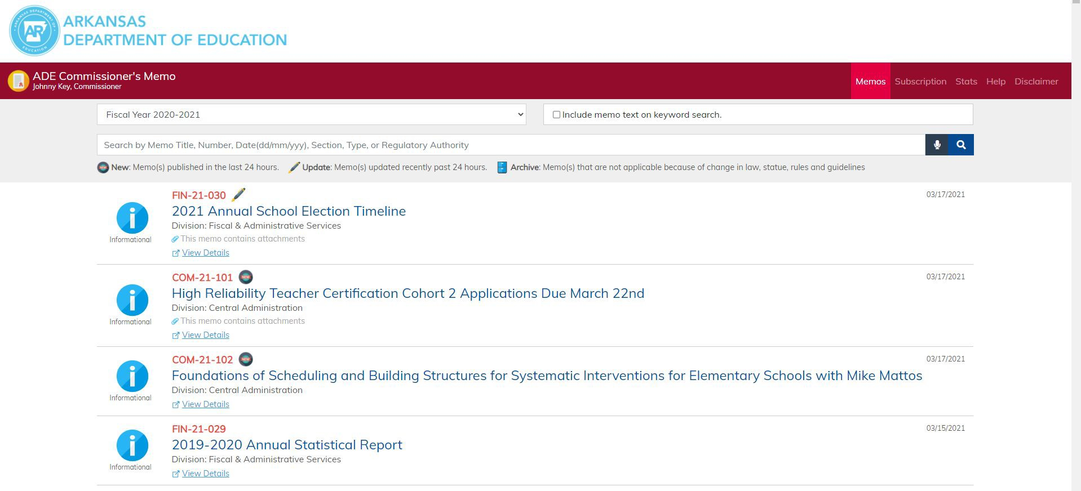
Check Commissioner’s Memos
Visit http://adecm.arkansas.gov/Default
.aspx to view Commissioner’s Memos.
The user may then scroll through the most recent memos or type in a specific number of memo.
Allocations are announced and revised through Commissioner’s Memos throughout the fiscal year.
Carryover amounts are also announced and revised through Commissioner’s Memos throughout the fiscal year.
109

Slide 110
Reminders & Resources
110

Slide 111
3-Month Snapshots
3-month snapshots from the Special Education Finance Unit are emailed to all LEA Supervisors and the FMS listserv each month.
Upcoming technical assistance and PD
Upcoming fiscal obligations
Updated guidance documents and charts
111

Slide 112
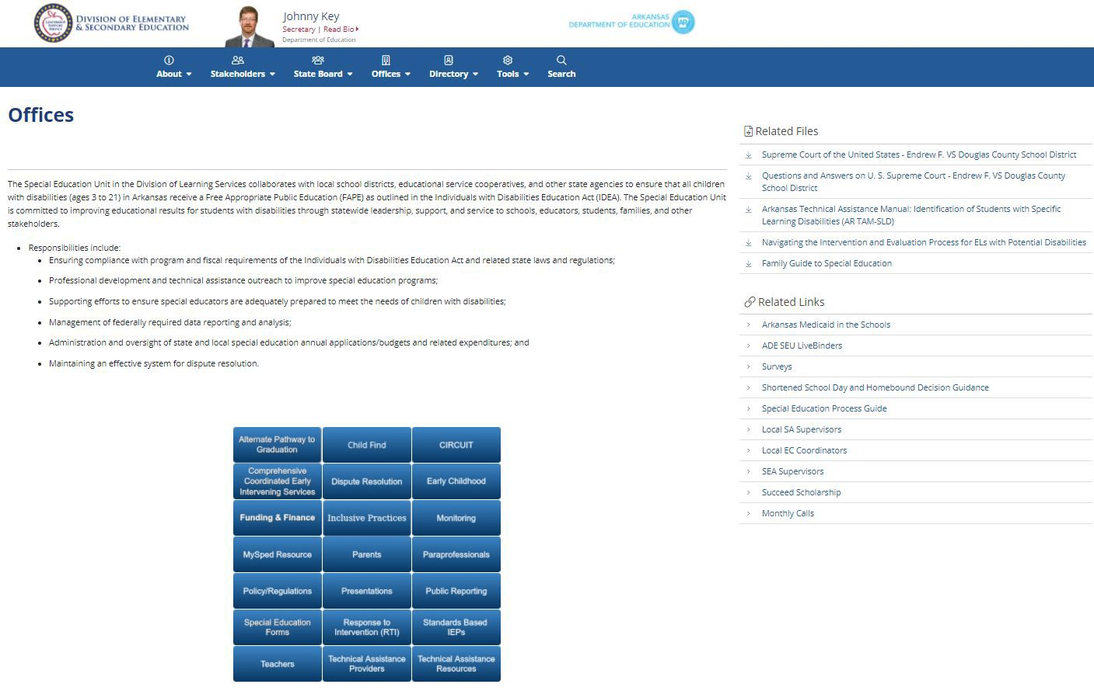
Monthly TA Calls
On the last Thursday of each month, the Special Education Unit offers a webinar.
Program Monitoring and SPED Finance share information, reminders and expectations.
Participants are able to ask questions, and a Powerpoint presentation accompanies each call.
112

Slide 113
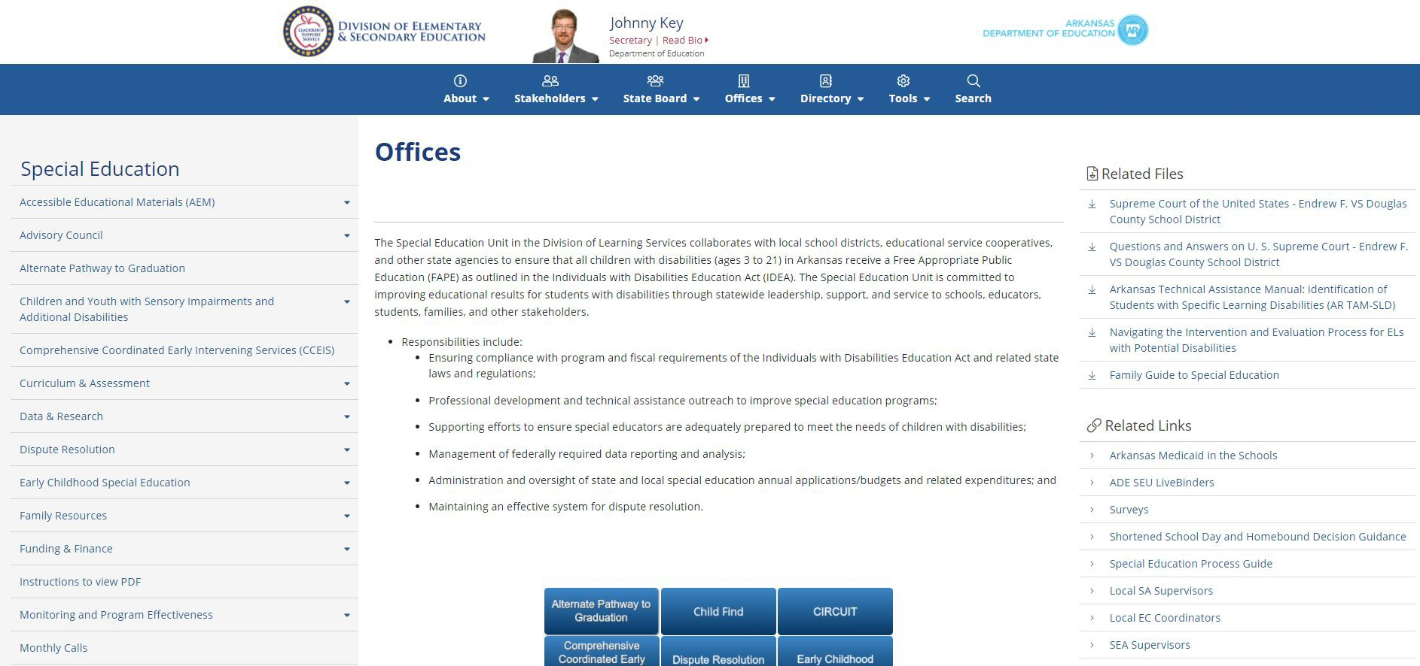
Special Education Website
The Special Education page is on the DESE website. https://dese.ade.arkansas.gov/Offices/special-education
113

Slide 114
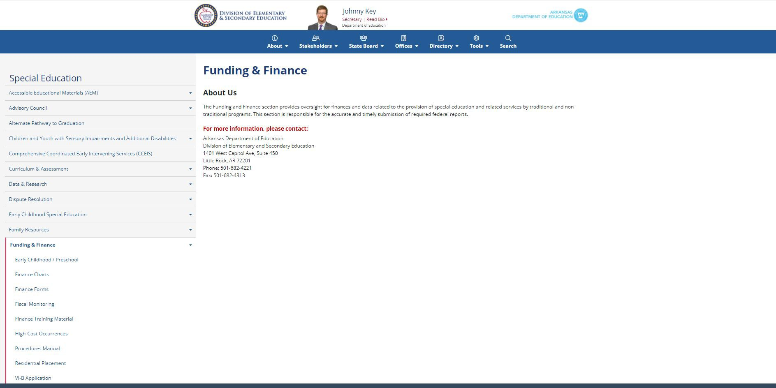
Special Education Website
114

Slide 115
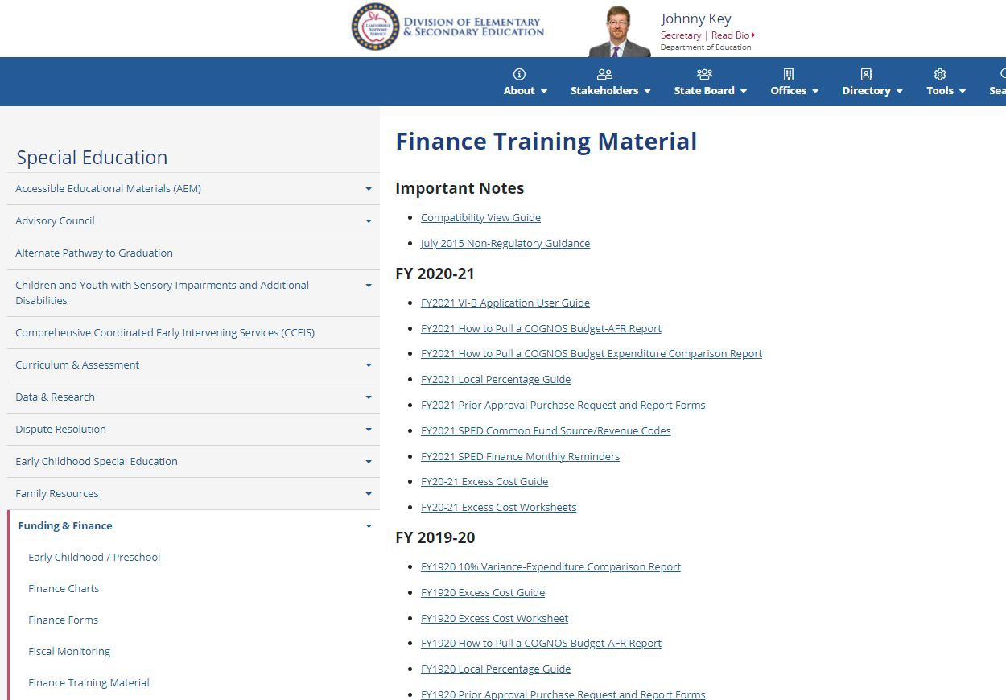
Updated Training Documents
Updated training documents are posted at the following link: https://dese.ade.arkansas.gov/O ffices/special-education/funding
-and-finance/finance-training-m aterial
115

Slide 116
Contact Information
Name | Phone | Email
Josh Hart | 501-682-4294 | josh.hart@ade.arkansas.gov
Mikki Eubank | 501-682-4293 | mikki.eubank@ade.arkansas.gov
Kim Vogt | 501-682-4295 | kim.vogt@ade.arkansas.gov
Heather O’Shields | 501-683-5869 | heather.oshields@ade.arkansas.gov
Patricia Siribouth | 501-683-3449 | patricia.siribouth@ade.arkansas.gov
*When emailing, please include the LEA number and district name in the subject line.*
116

